Slide 1




STATISTICS ESSENTIALS
Accredited by IABAC™

Slide 2

Overview of Statistics
Module - 1

Slide 3
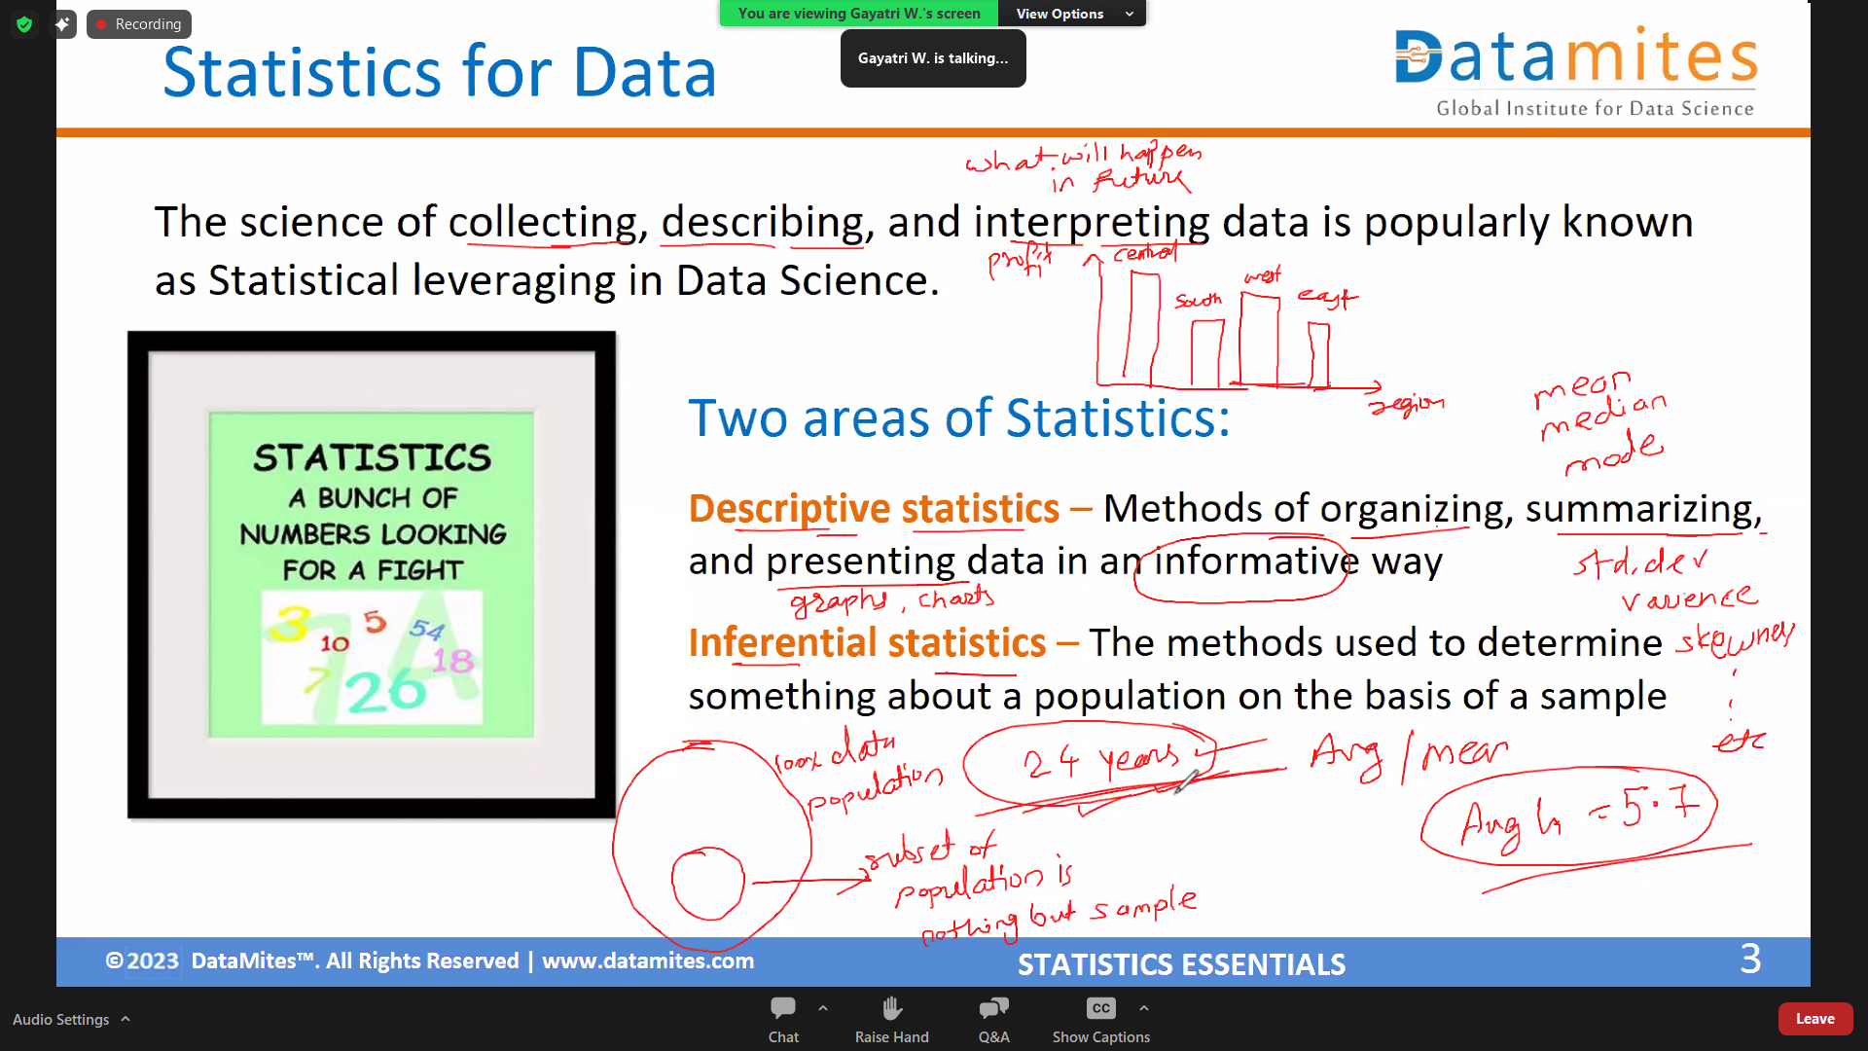

Slide 4
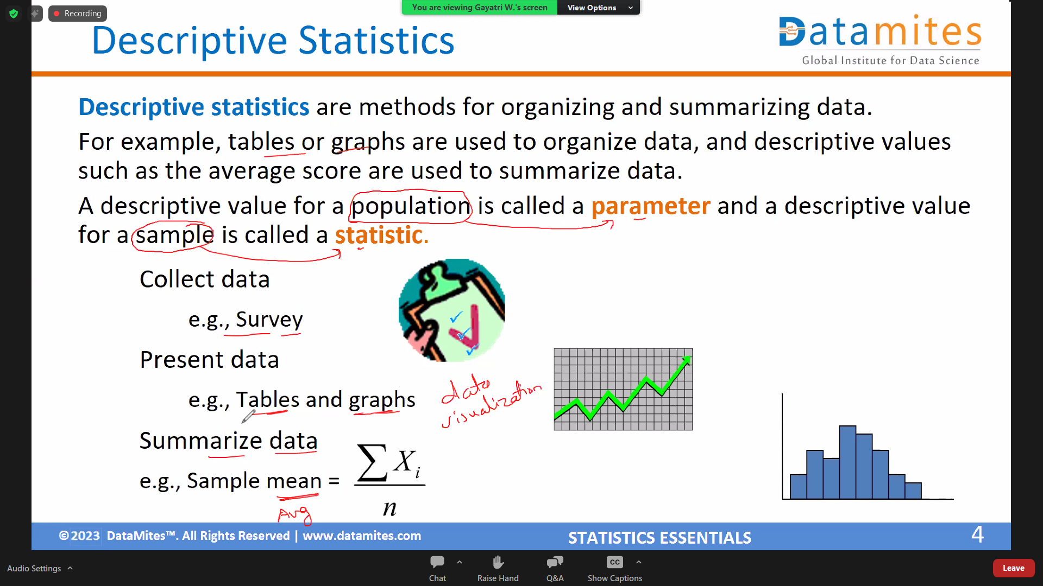

Slide 5
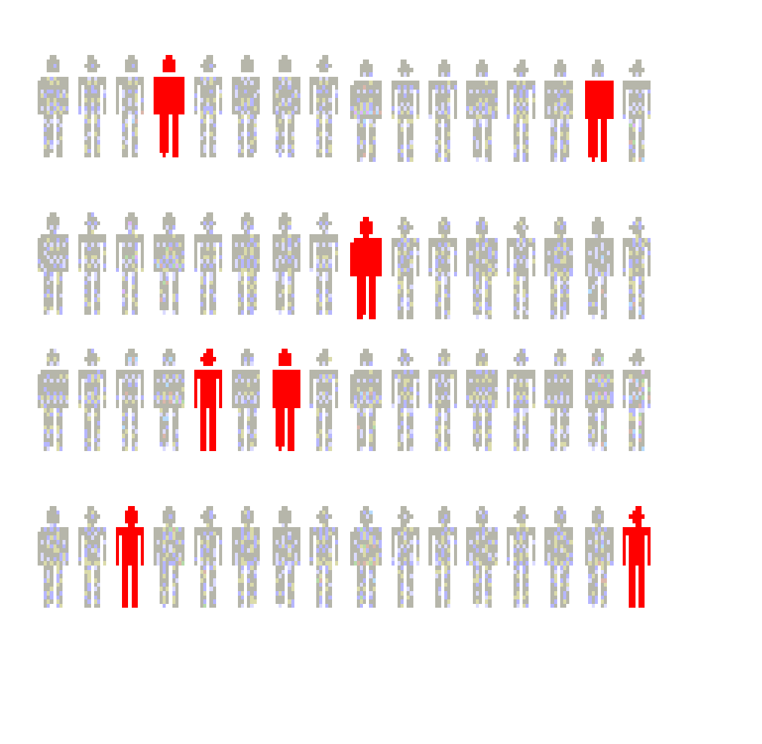
Inferential Statistics
Inferential statistics are methods for using sample data to make general conclusions (inferences) about populations.
Because a sample is typically only a part of the whole population, sample data provide only limited information about the population. As a result, sample statistics are generally imperfect representatives of the corresponding population parameters.
Estimation
e.g., Estimate the population mean weight using the sample mean weight
Hypothesis testing
e.g., Test the claim that the population mean weight is 70 kg
Inference is the process of drawing conclusions or making decisions about a population based on sample results

Slide 6
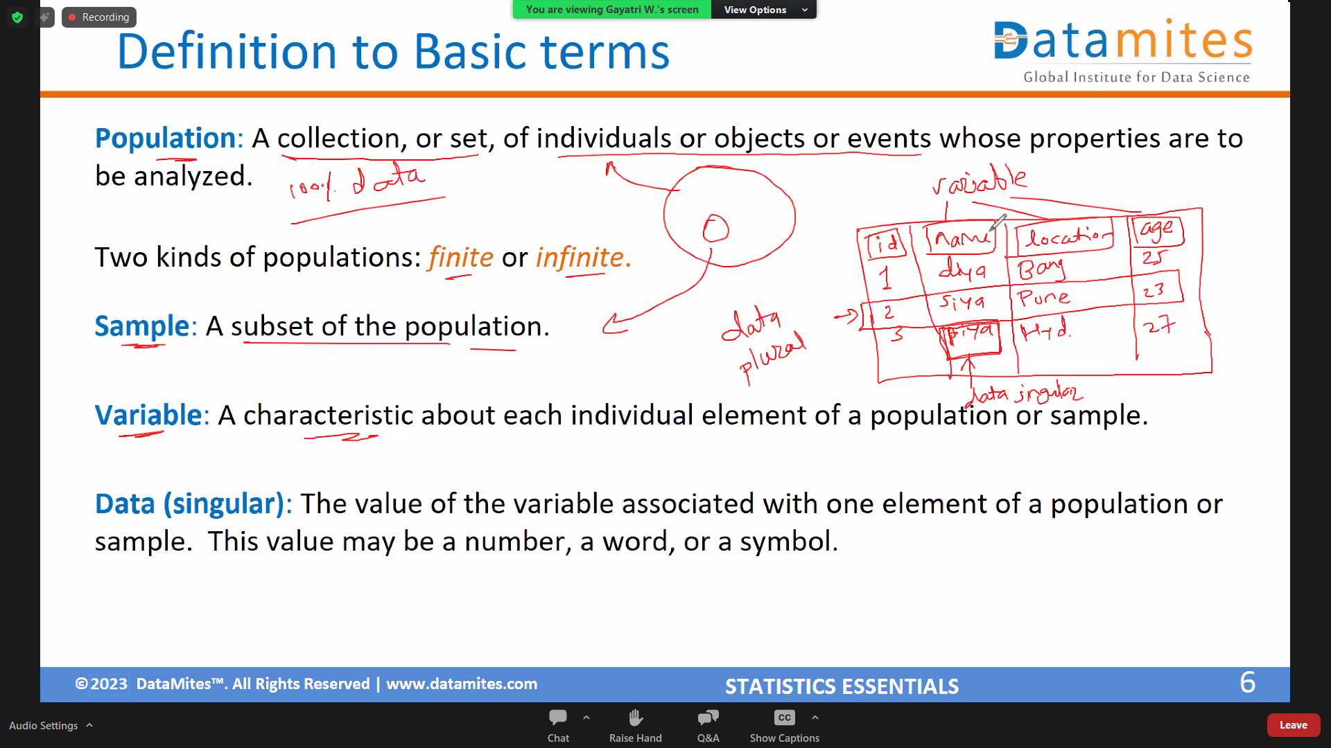

Slide 7
Definition to Basic terms
Data (plural): The set of values collected for the variable from each of the elements belonging to the sample.
Random Variable: Variable are placeholder where you can store anything. It can number , or string , sentences.
Experiment: A planned activity whose results yield a set of data.
Parameter: A numerical value summarizing all the data of an entire population.
Statistic: A numerical value summarizing the sample data.

Slide 8
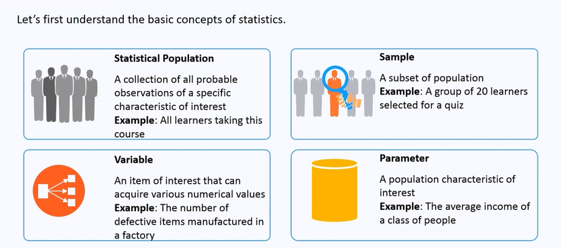
Examples

Slide 9
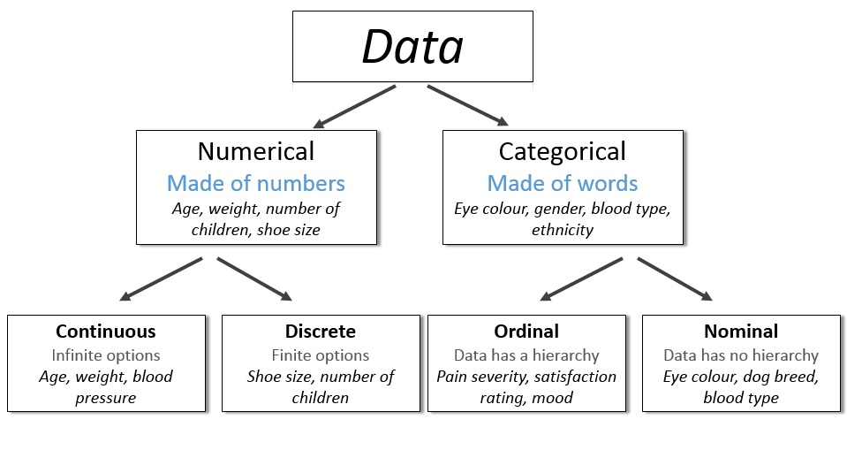
Types of Data
Continuous (Can take any fractional value)
Ordinal (Ordered categories, ranking matters)
Discrete (Countable whole numbers)
Nominal (Categories, no order)

Slide 10
Examples of variables
Example: Identify each of the following as examples of qualitative or numerical variables:
1. The temperature in Barrow, Alaska at 12:00 pm on any
given day. -> Numerical
2. The model of automobile. -> qualitative
3. Whether or not a 6 volt lantern battery is defective. -> qualitative
4. The weight of a lead pencil. -> Numerical
5. The length of time billed for a long distance telephone call. -> Numerical
6. The brand of cereal children eat for breakfast. -> qualitative
7. The type of book taken out of the library by an adult. -> qualitative

Slide 11
Examples of variables…
Example: Identify each of the following as examples of
nominal, (2) ordinal, (3) discrete, or (4) continuous variables:
The length of time until a pain reliever begins to work. -> continuous
The number of chocolate chips in a cookie. -> discrete
The number of colors used in a statistics textbook. -> discrete
The brand of refrigerator in a home. -> nominal
The overall satisfaction rating of a new car. -> ordinal
The number of files on a computer’s hard disk. -> discrete
The pH level of the water in a swimming pool. -> continuous
The number of staples in a stapler. -> discrete

Slide 12
The number of students in a classroom. -> discrete The type of cuisine (Italian, Mexican, Chinese, etc.). -> nominal The ranking of contestants in a singing competition. -> ordinal
The weight of a newborn baby. -> continuous The number of pets owned by a family. -> discrete The brand of mobile phone owned by a person. -> nominal The temperature of a cup of coffee. -> continuous
The number of floors in a building. -> discrete The level of education (High School, Bachelor's, Master's, PhD) -> ordinal
The distance a person runs in a marathon. -> continuous
The number of languages a person speaks. -> discrete The size of a T-shirt (Small, Medium, Large, etc.). -> ordinal The time it takes to finish a race. -> continuous The type of transportation used to commute (Bus, Car, Train). -> nominal The number of words in a book. -> discrete The shoe size of a person. -> discrete The amount of water in a swimming pool. -> continuous The number of children in a family. -> discrete The hair color of students in a class. -> nominal The GPA of a student. -> continuous
Discrete → Countable number of students. Nominal → Categories with no ranking. Ordinal → Contest ranking matters (1st, 2nd, 3rd, etc.). Continuous → Weight can have decimal values. Discrete → Number of pets is countable. Nominal → Phone brands are categories without order. Continuous → Temperature can be any value. Discrete → Floors in a building are countable. Ordinal → Education levels have an order. Continuous → Distance can take decimal values. Discrete → Number of languages is countable. Ordinal → T-shirt sizes have a ranking. Continuous → Time can take decimal values. Nominal → Transportation types are categories. Discrete → Words in a book are countable. Ordinal → Shoe sizes follow a ranking.
Continuous → Water amount can take decimal values. Discrete → Number of children is countable.
Nominal → Hair colors are just categories. Continuous → GPA can have decimal values

Slide 13
Harnessing Data
Module - 2

Slide 14
Steps Involved In Descriptive Statistics
Collecting the data
Presenting the data-->Visualization using Matplotlib and Seaborn.
Summarizing the data-->Module 3

Slide 15
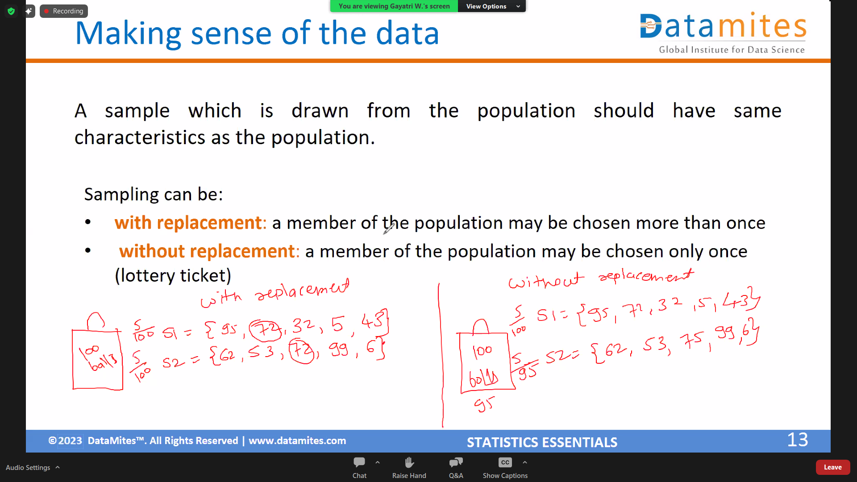

Slide 16
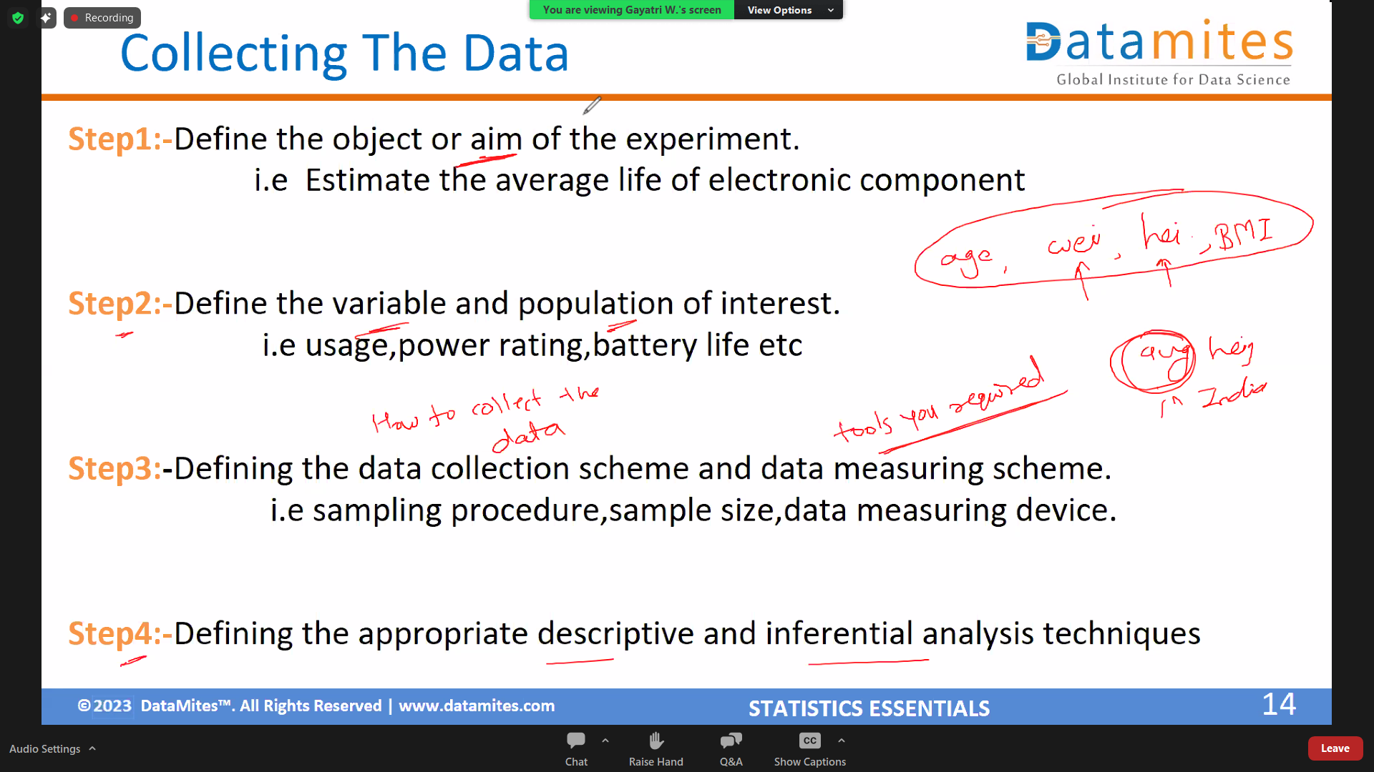
# Aim of the experiment is to calculate the avg height of people in India

Slide 17
Methods Used To Collect Data
Experiment: The investigator controls or modifies the environment and observes the effect on the variable under study.
Survey: Data are obtained by sampling some of the population of interest. The investigator does not modify the environment.
Census: A 100% survey. Every element of the population is listed. Seldom used: difficult and time-consuming to compile, and expensive.
Judgment Samples: It is a non-probability sampling technique in which the sample members are chosen only on the basis of the researcher's knowledge and judgment.
Probability Samples: Samples in which the elements to be selected are drawn on the basis of probability. Each element in a population has a certain probability of being selected as part of the sample.

Slide 18
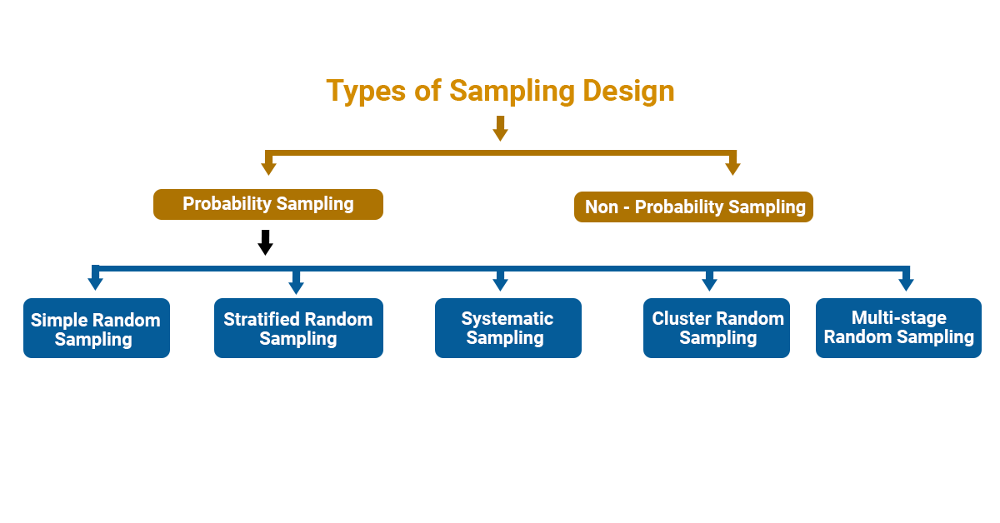
Types Of Sampling

Slide 19
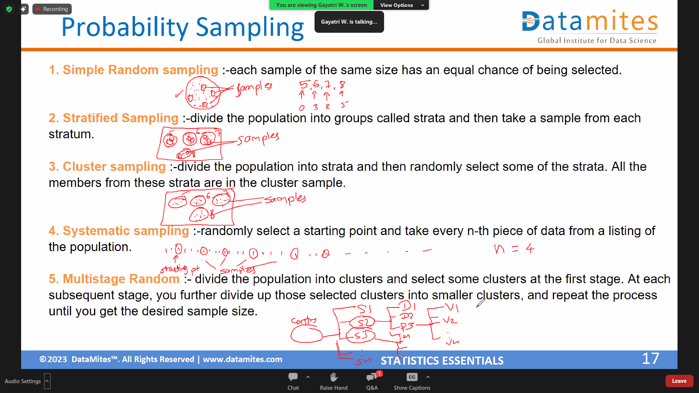
wasd

Slide 20
Sampling Example
This is just an example of Simple Random Sampling
Example: An employer is interested in the time it takes each employee to commute to work each morning. A random sample of 35 employees will be selected and their commuting time will be recorded.
There are 2712 employees.
Each employee is numbered: 0001, 0002, 0003, etc. up to 2712.
Using four-digit random numbers, a sample is identified: 1315, 0987, 1125, etc.

Slide 21
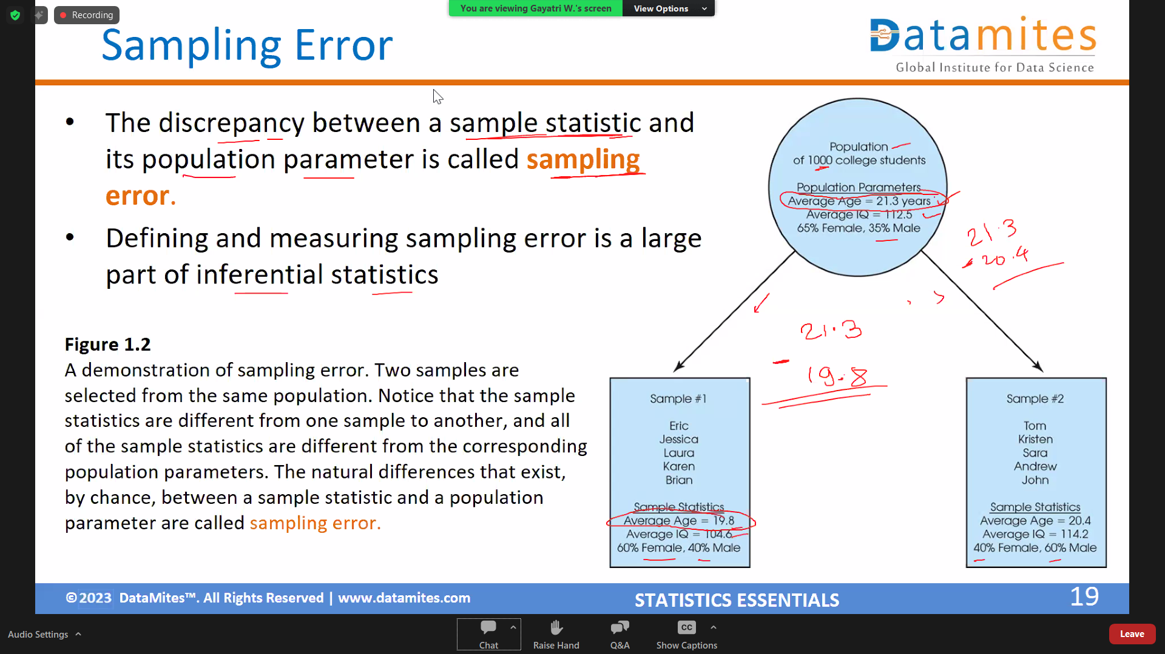
Difference
From the sample we are estimating about the population

Slide 22
Exploratory Analysis
Module - 3

Slide 23
Measures of Central Tendencies

Slide 24
Central Tendency
The property of data being concentrated in the centre.

Slide 25
Measures of Central Tendency
Mean
Median
Mode

Slide 26
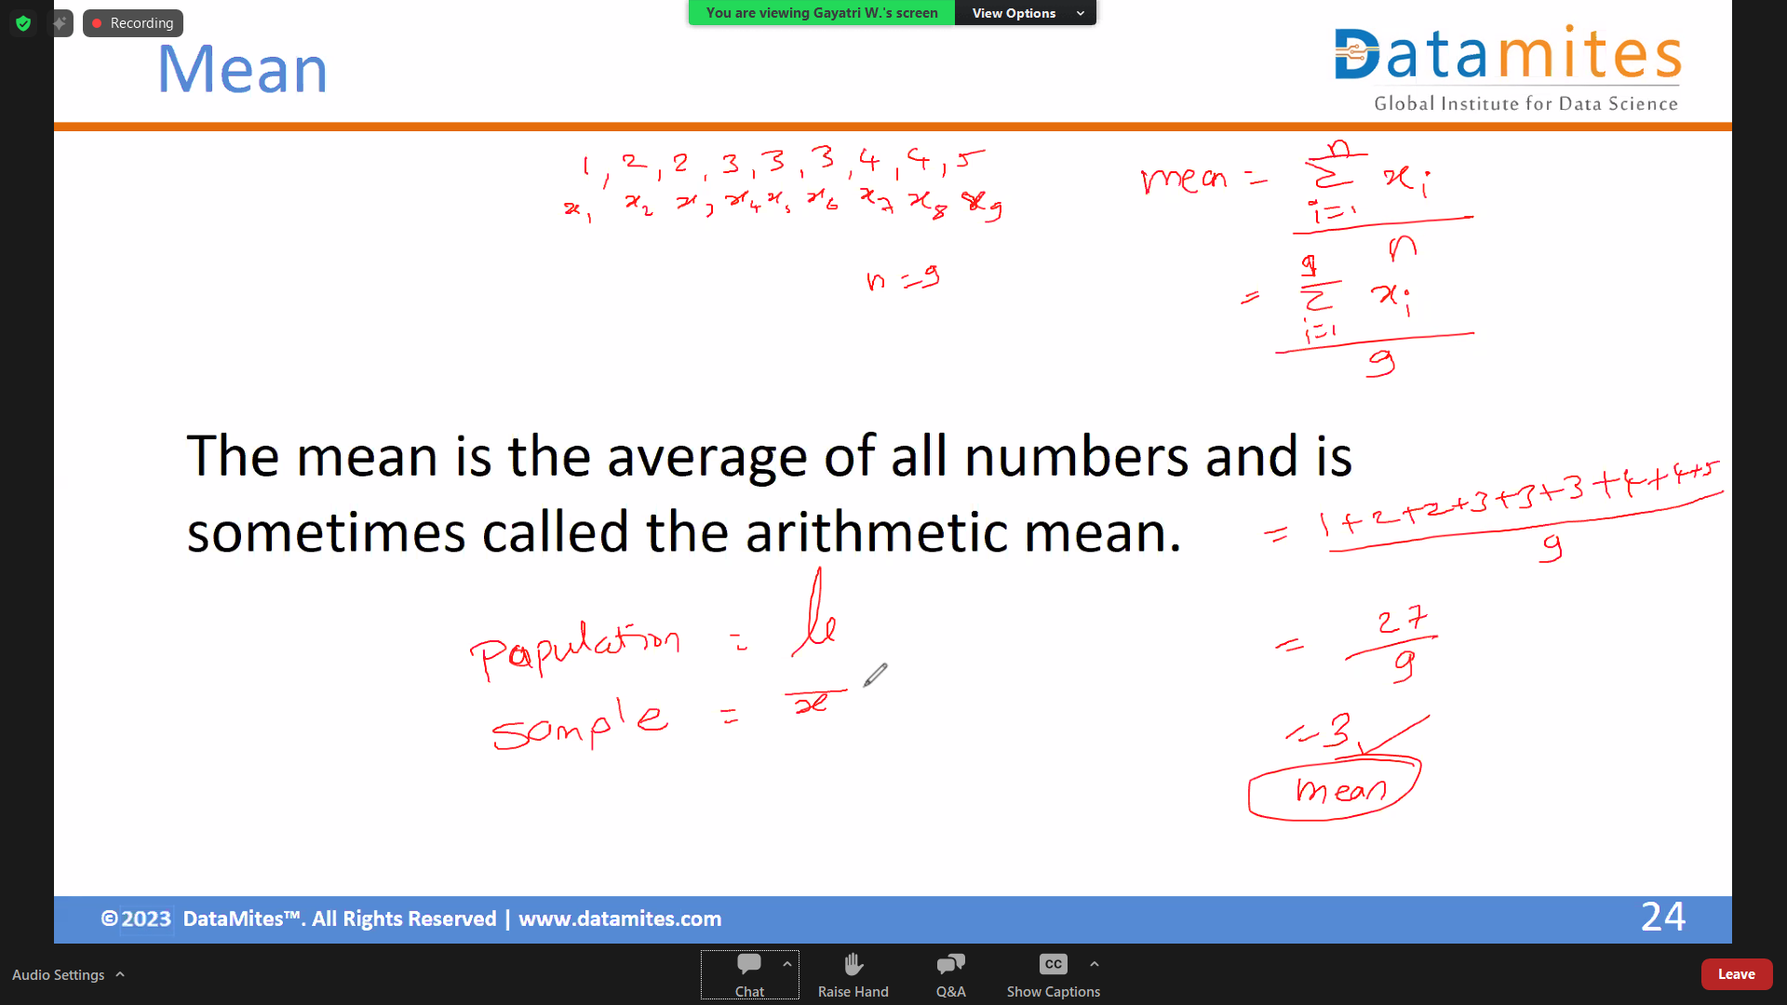

Slide 27
Median
The statistical median is the middle number in a sequence of numbers. To find the median, organize each number in order by size; the number in the middle is the median
Median is the middle value in dataset by arranging values in asc or dsc order
Ex 1 - 2 5 6 8 1 4 3
1 2 3 4 5 6 8
Number of elements (N) = 7 which is odd
Median = 4
Ex 2 – 1 2 3 4 5 6 8 10
Number of elements (N) = 8 which is even
Median = 4 + 5 / 2 = 9/2 = 4.5
Median = 4.5

Slide 28
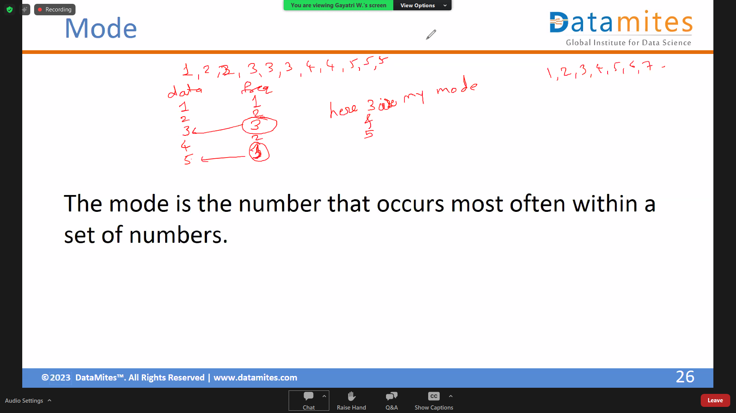

Slide 29
Measure of Spread / Data Variability
Range
Interquartile Range (IQR)
Standard Deviation
Variance
Range and IQR works with only 2 data points
Range = 3-1 = 2
IQR = Q3 – Q1 = 50% of middle data

Slide 30
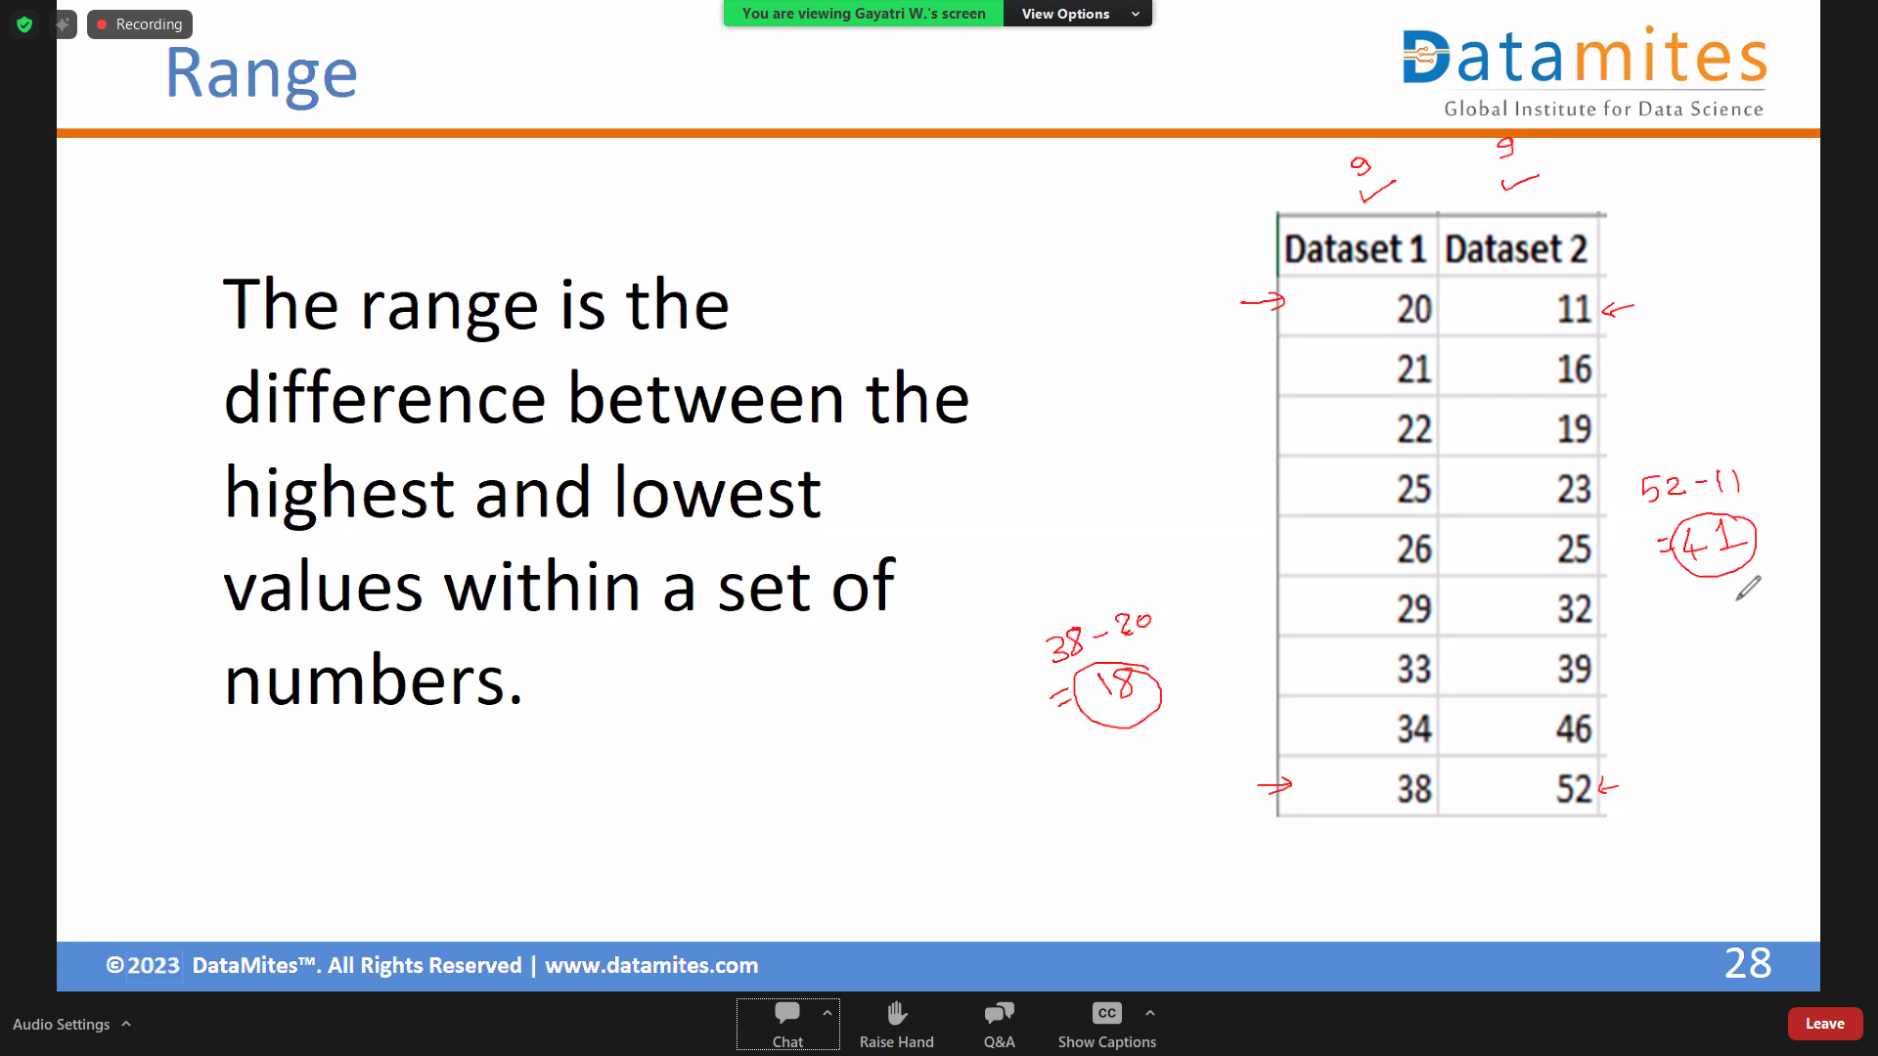

Slide 31
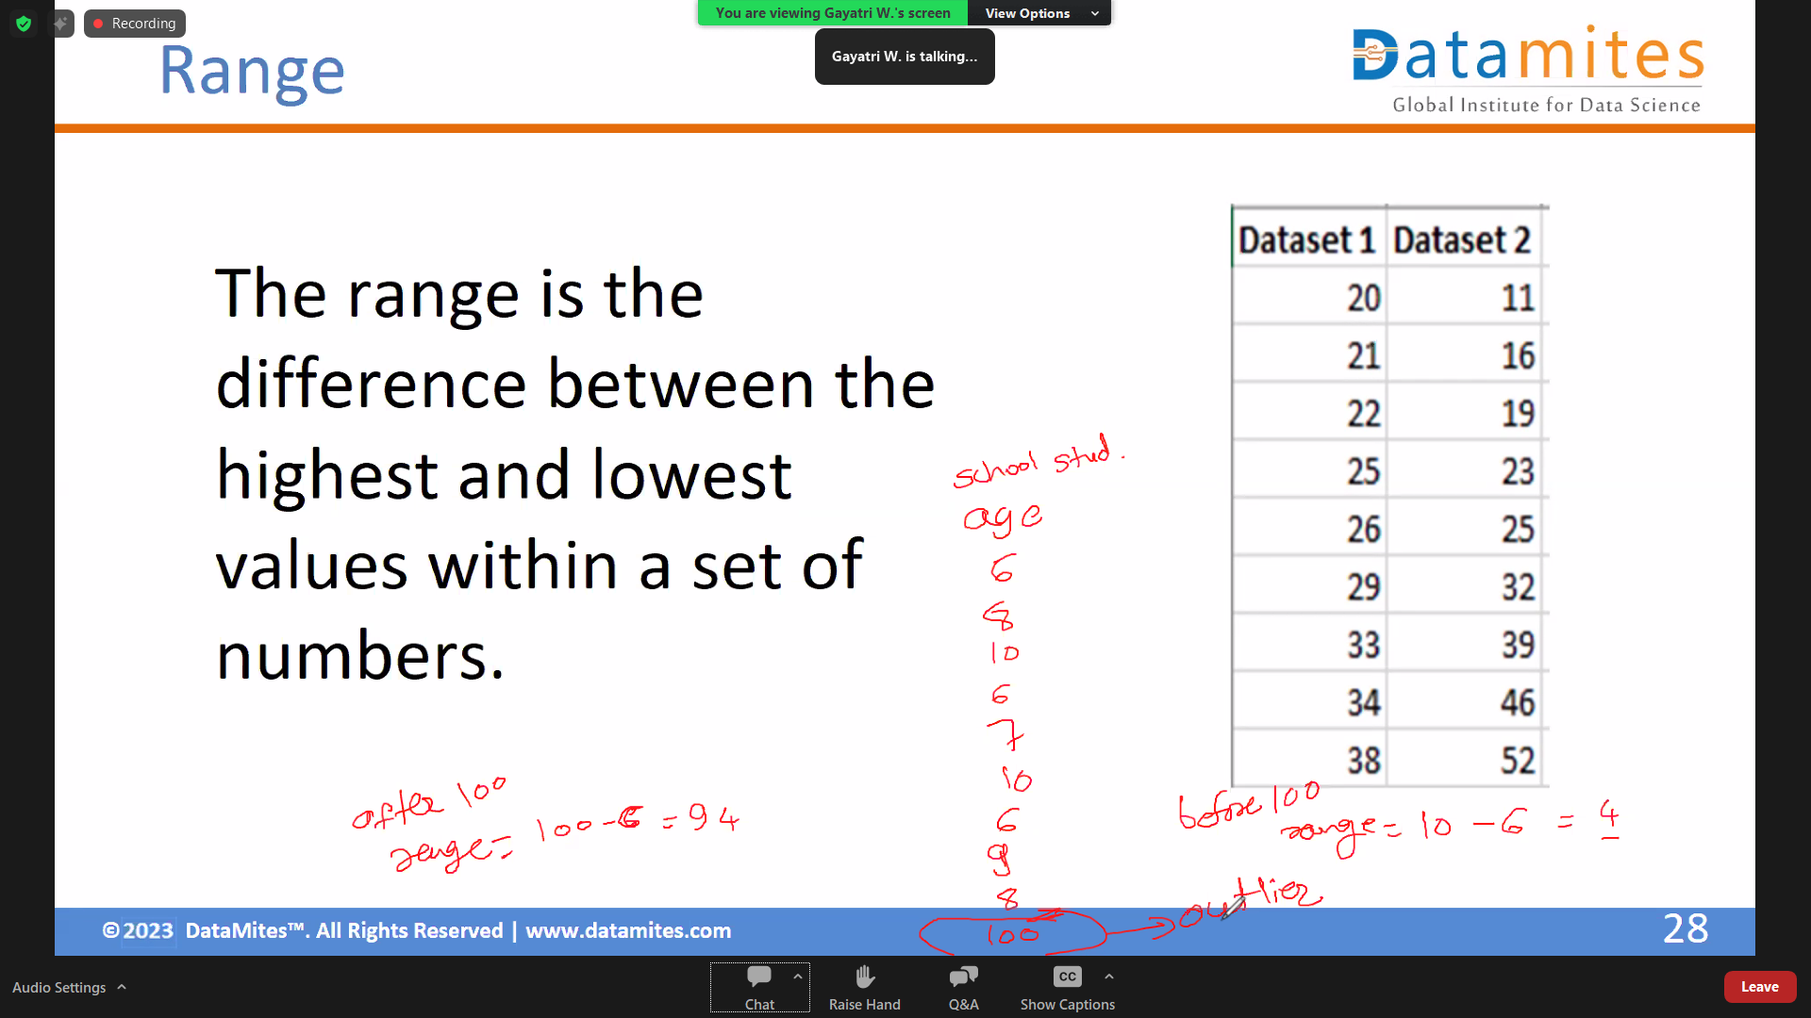

Slide 32
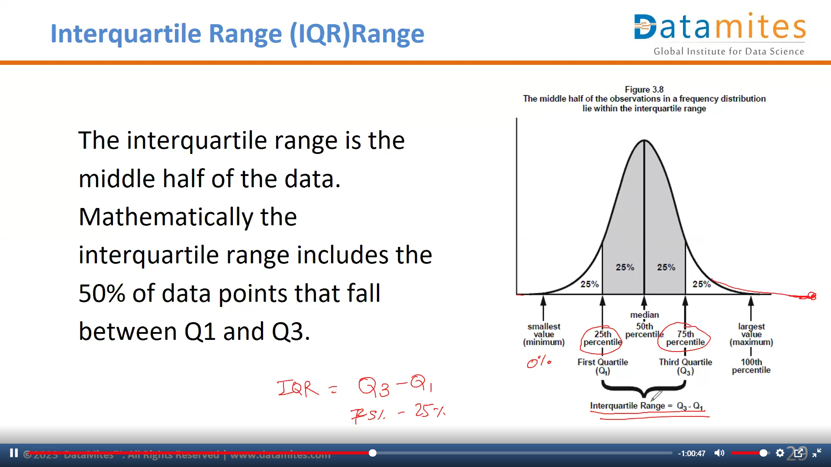

Slide 33
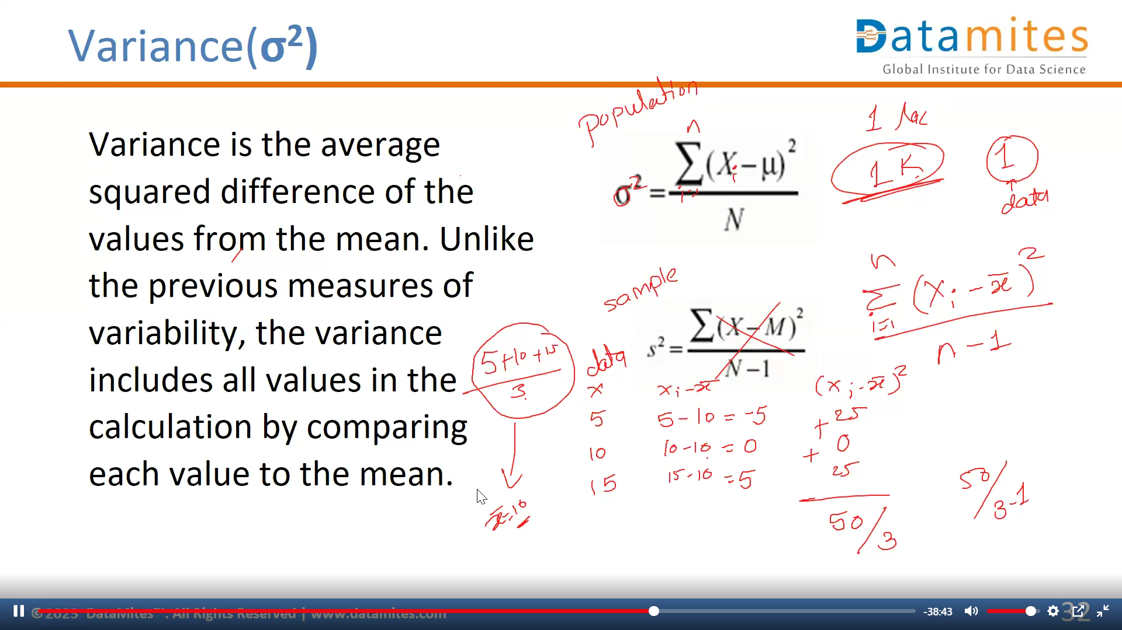
Variance is deonted by sigma which is sigma squred
After getting squared we have to do summation of it means addition of it
Mean
For Sample
For population

Slide 34
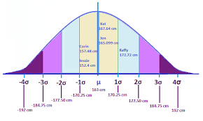
Standard Deviation (σ)
Standard Deviation (SD) is a measure that is used to quantify the amount of variation or dispersion of a set of data values.

Slide 35
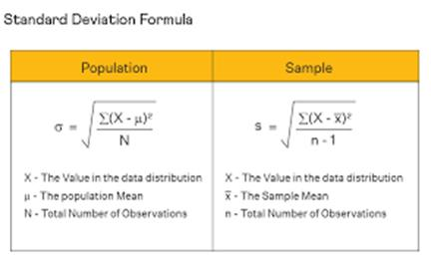

Standard Deviation (σ)

Slide 36
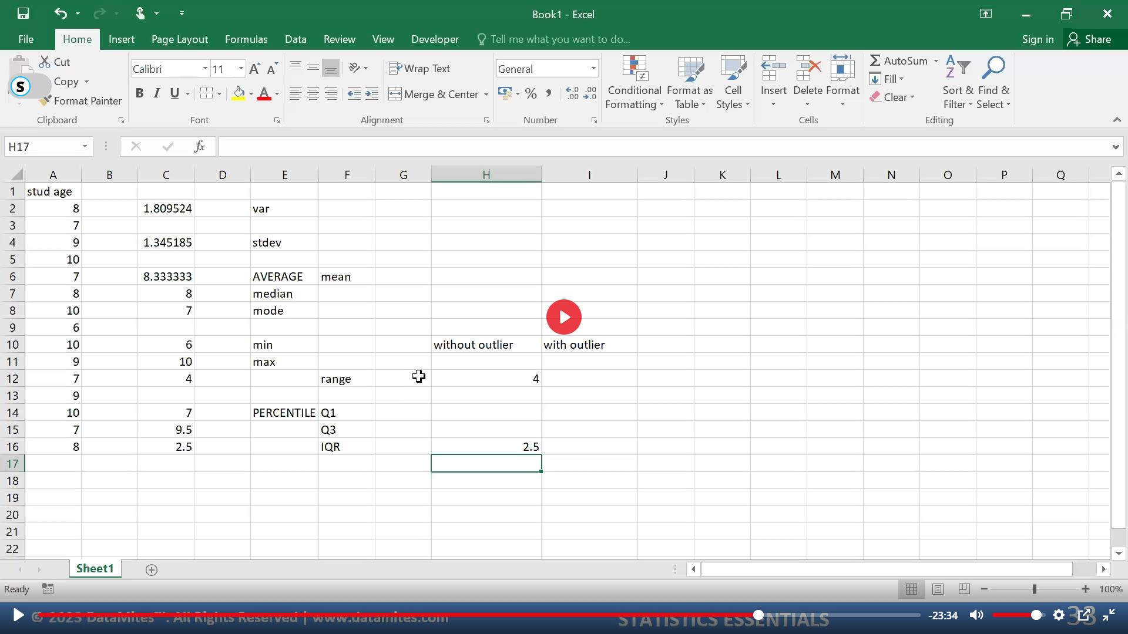
=VAR(A2:A16)
=STDEV(A2:A16)
=AVERAGE(A2:A16) which is mean
=MEDIAN(A2:A16)
=MODE(A2:A16)
=MIN(A2:A16) minimum value
=MAX(A2:A16) maximum value
=Cell of max – cell of min = Range
=PERCENTILE(A2:A16,0.25) Which is Q1
=PERCENTILE(A2:A16,0.75) Which is Q3
=Cell of Percentile Q3 - Cell of Percentile Q1

Slide 37
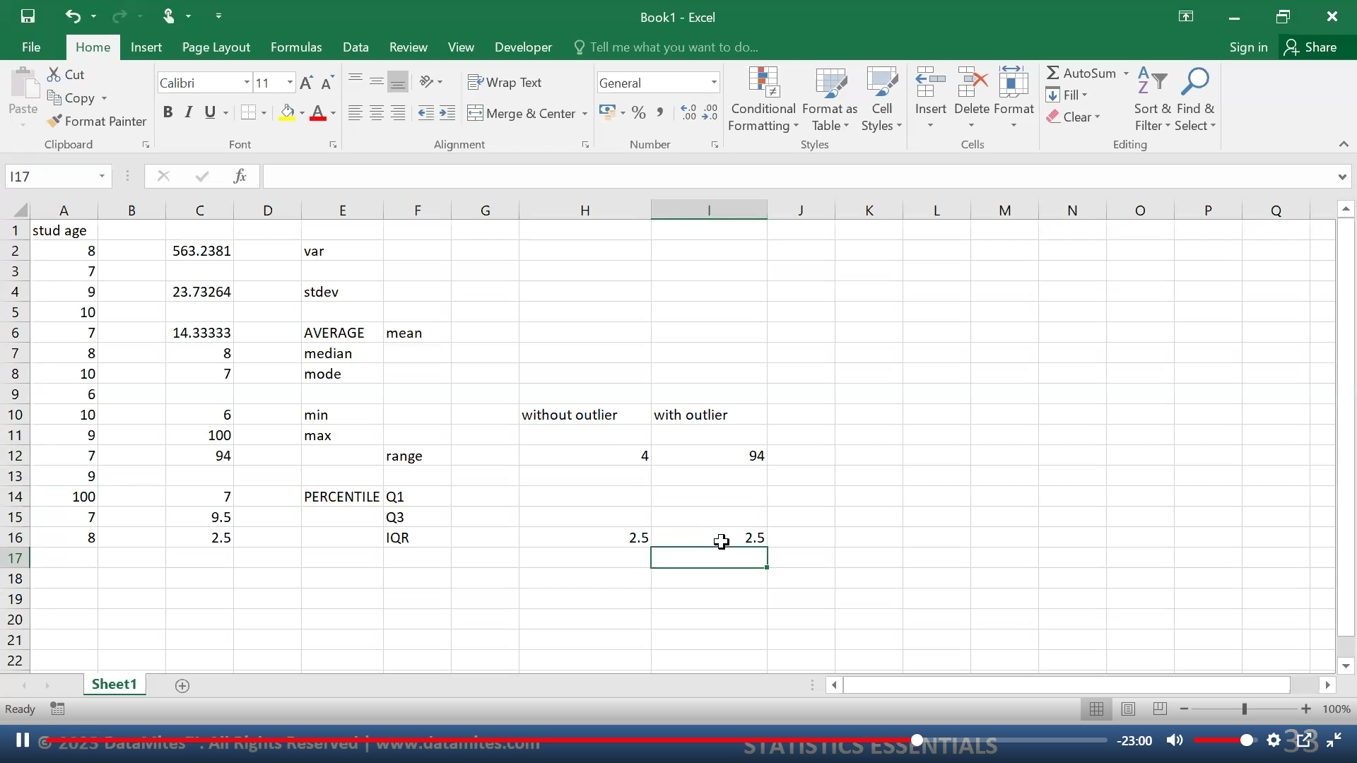

Slide 38
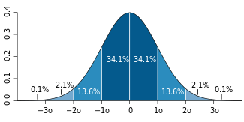
Percentile
A percentile (or a centile) is a measure used in statistics indicating the value below which a given percentage of observations in a group of observations fall.

Slide 39
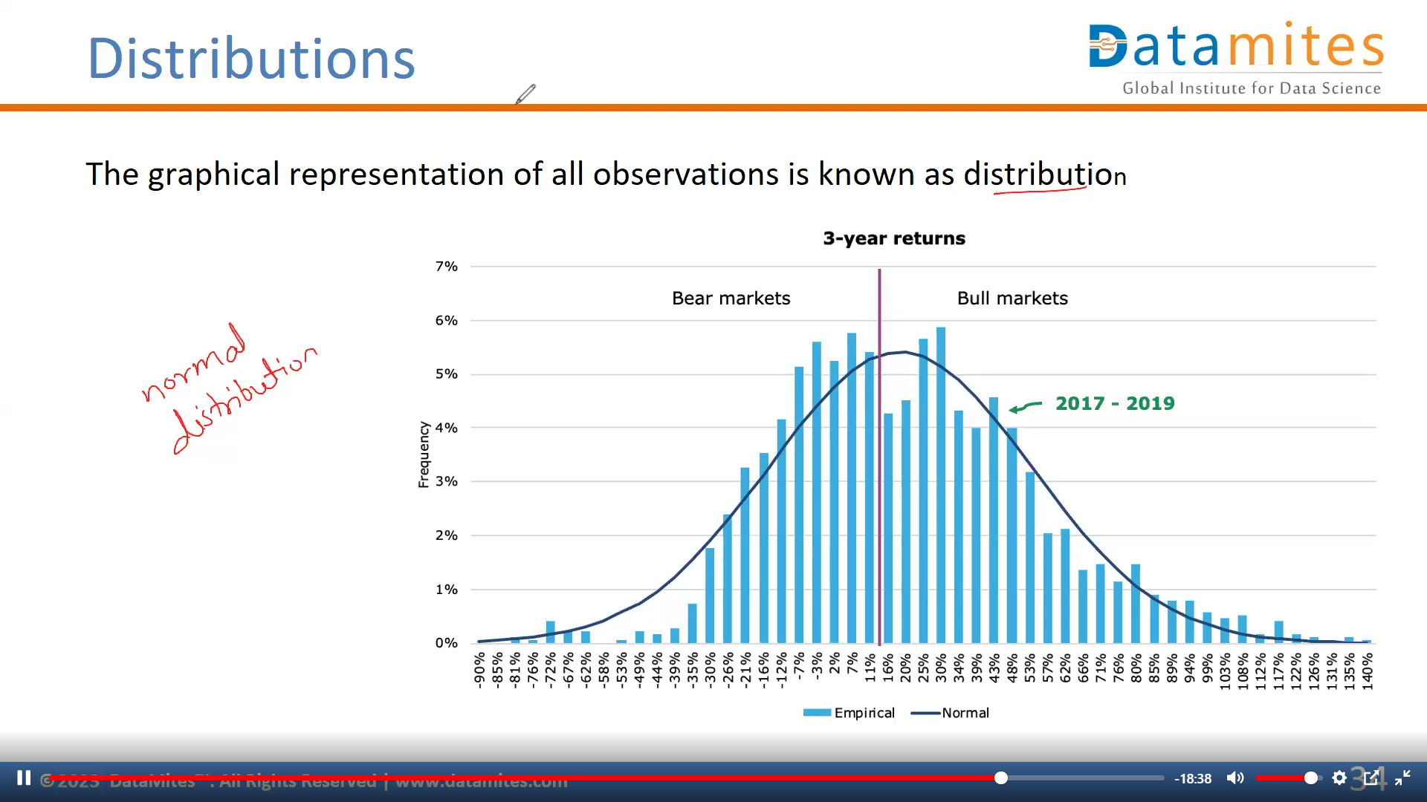

Slide 40
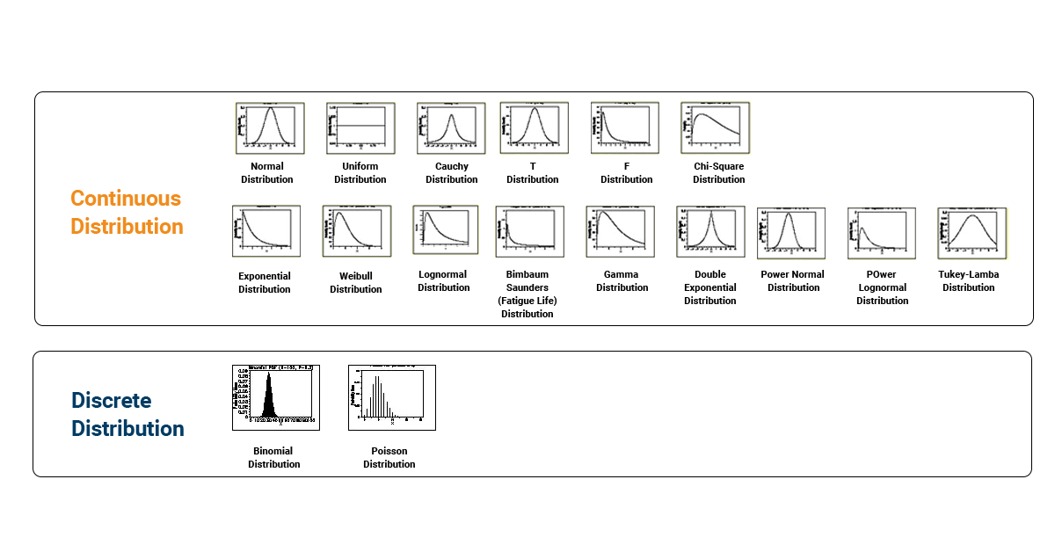
Types Of Distributions

Slide 41
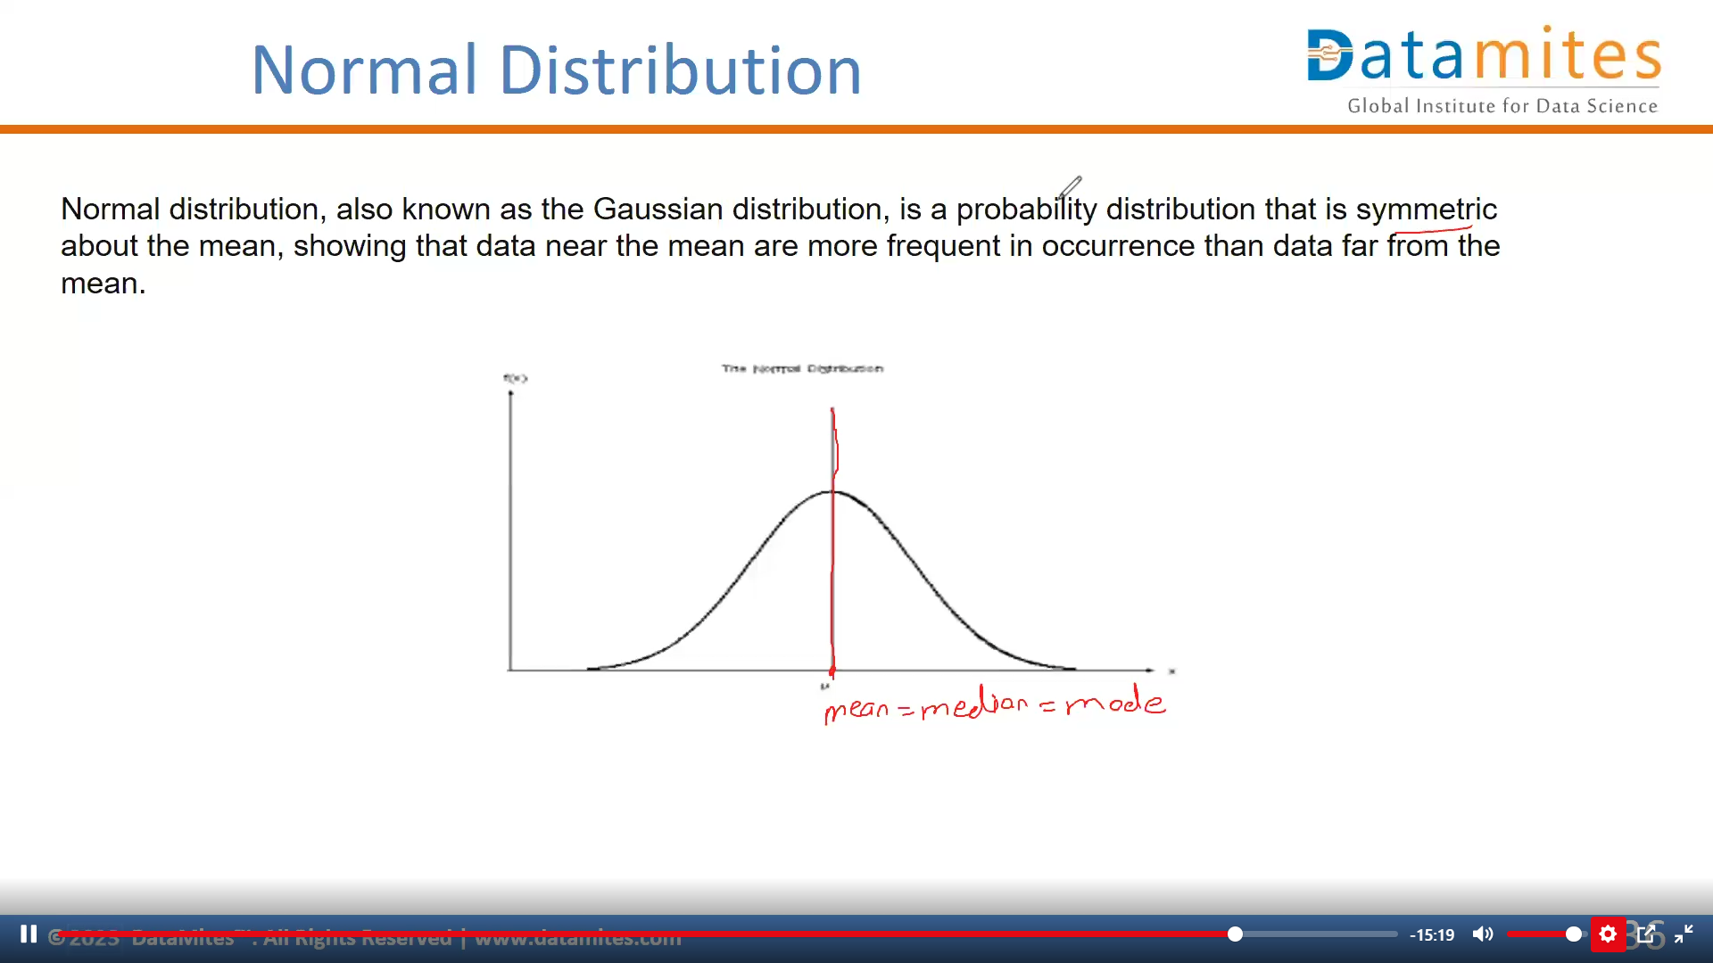

Slide 42
Properties Of Normal Distribution
Empirical Rule
Distortion in Normal Distribution
Central Limit Theorem
Standard Normal Distribution
Outliers
QQ plot
Log,Sqrt,Boxcox transformation - Correcting Distortion in Normal Distribution

Slide 43
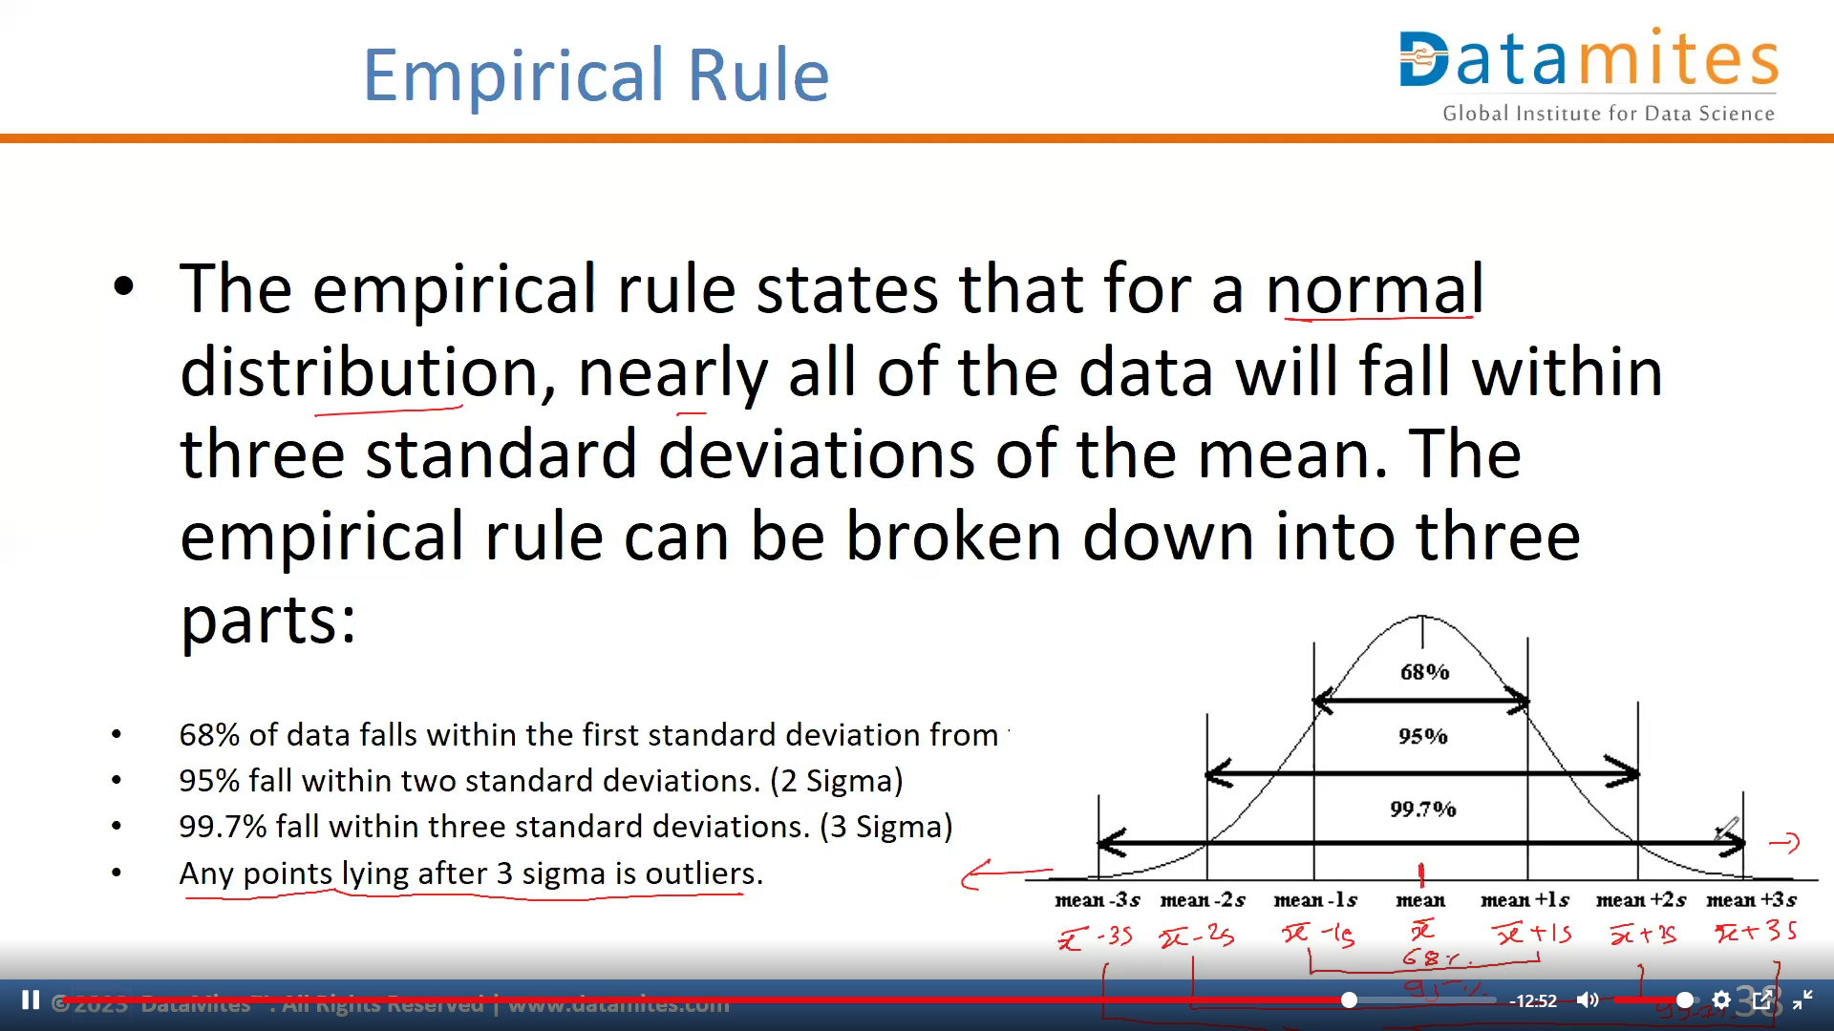

Slide 44
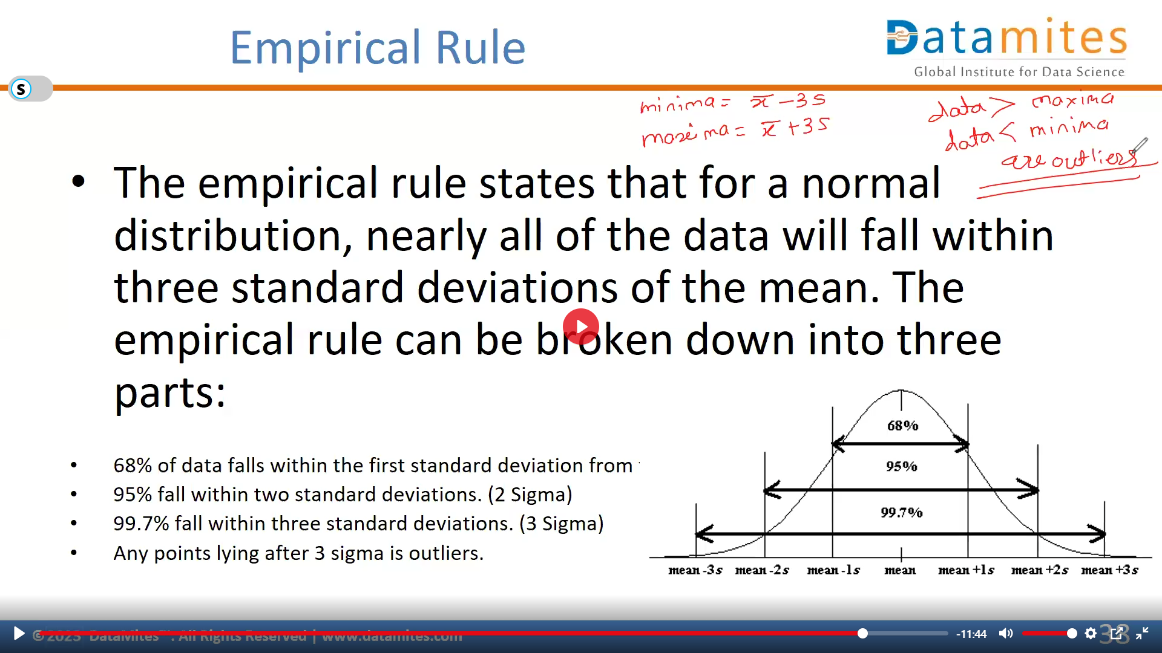

Slide 45
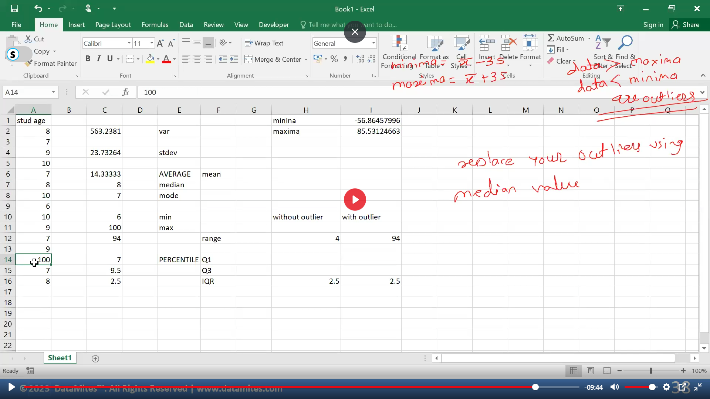


Minima =C6-3*C4 where C6 is Mean | C4 is Stdev
Maxima = C6+3*C4
Values of this data are outliers if > and <
So to remove this outlier with the median

Slide 46
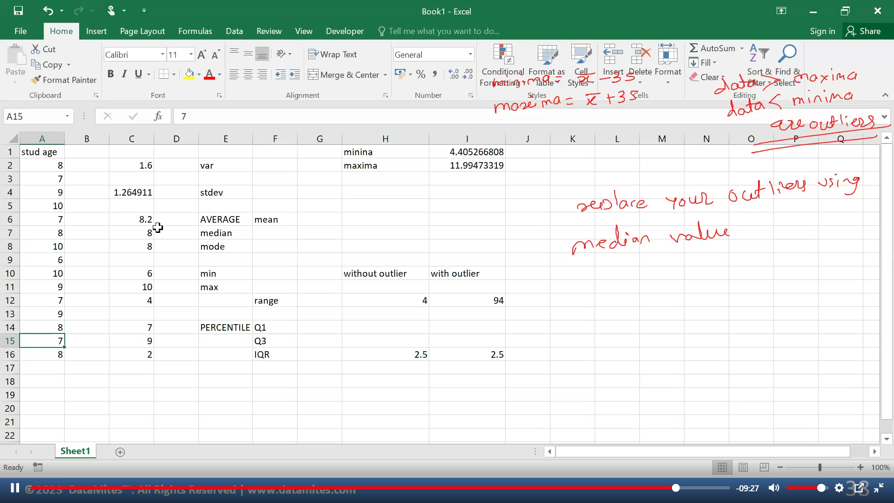
After changing outlier with median all things change

Slide 47
Distortion in Normal Distribution
The distortion in normally distributed curves can be quantified in 2 ways
Skewness
Kurtosis

Slide 48
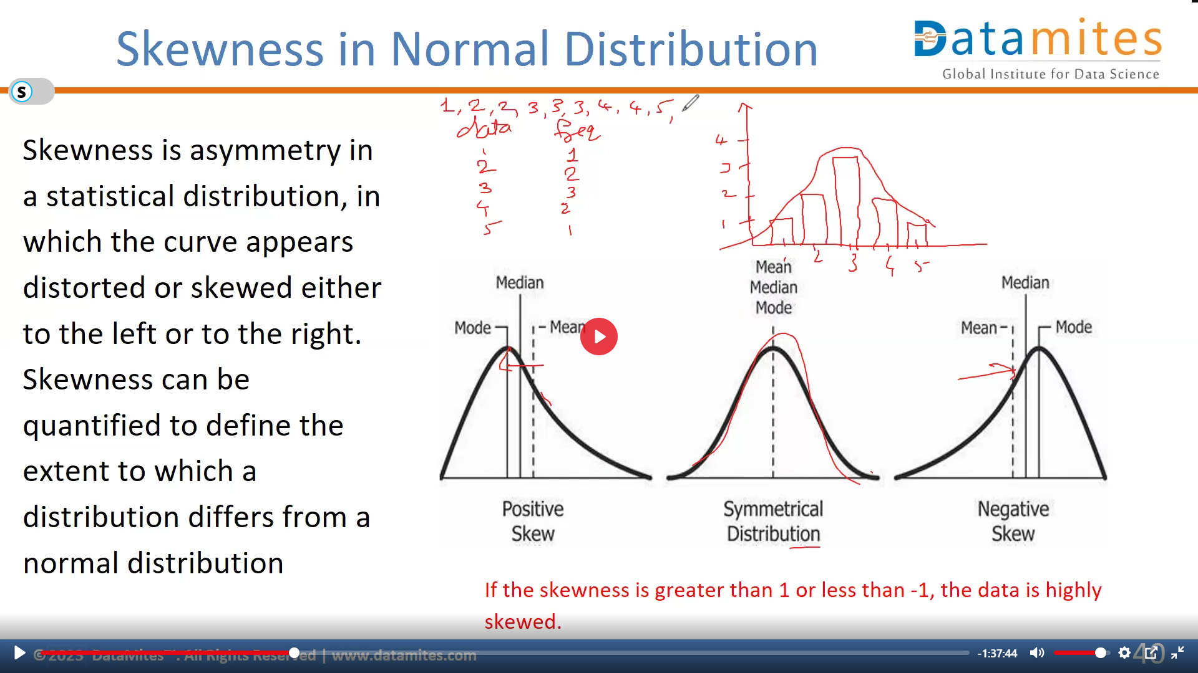

Slide 49
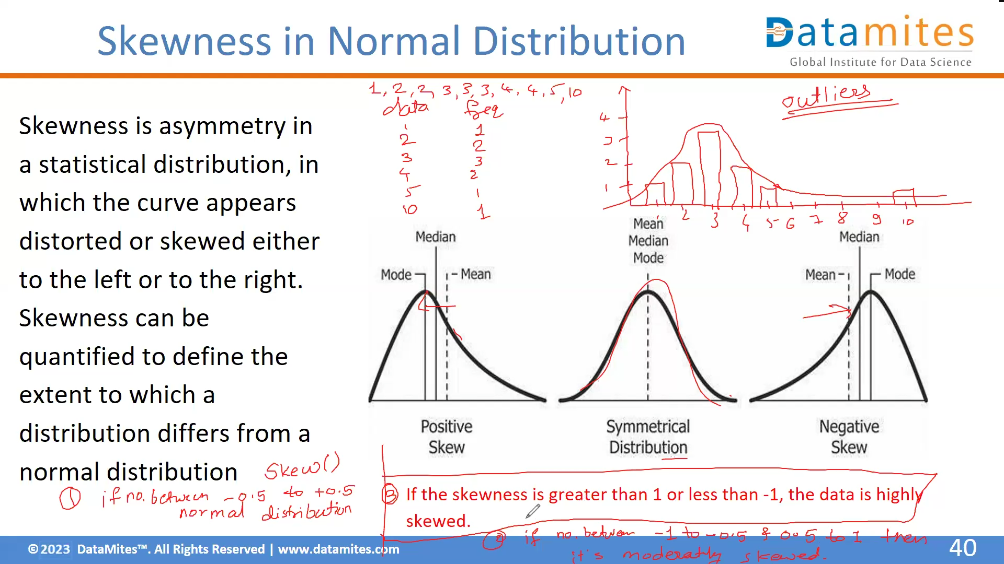

Slide 50
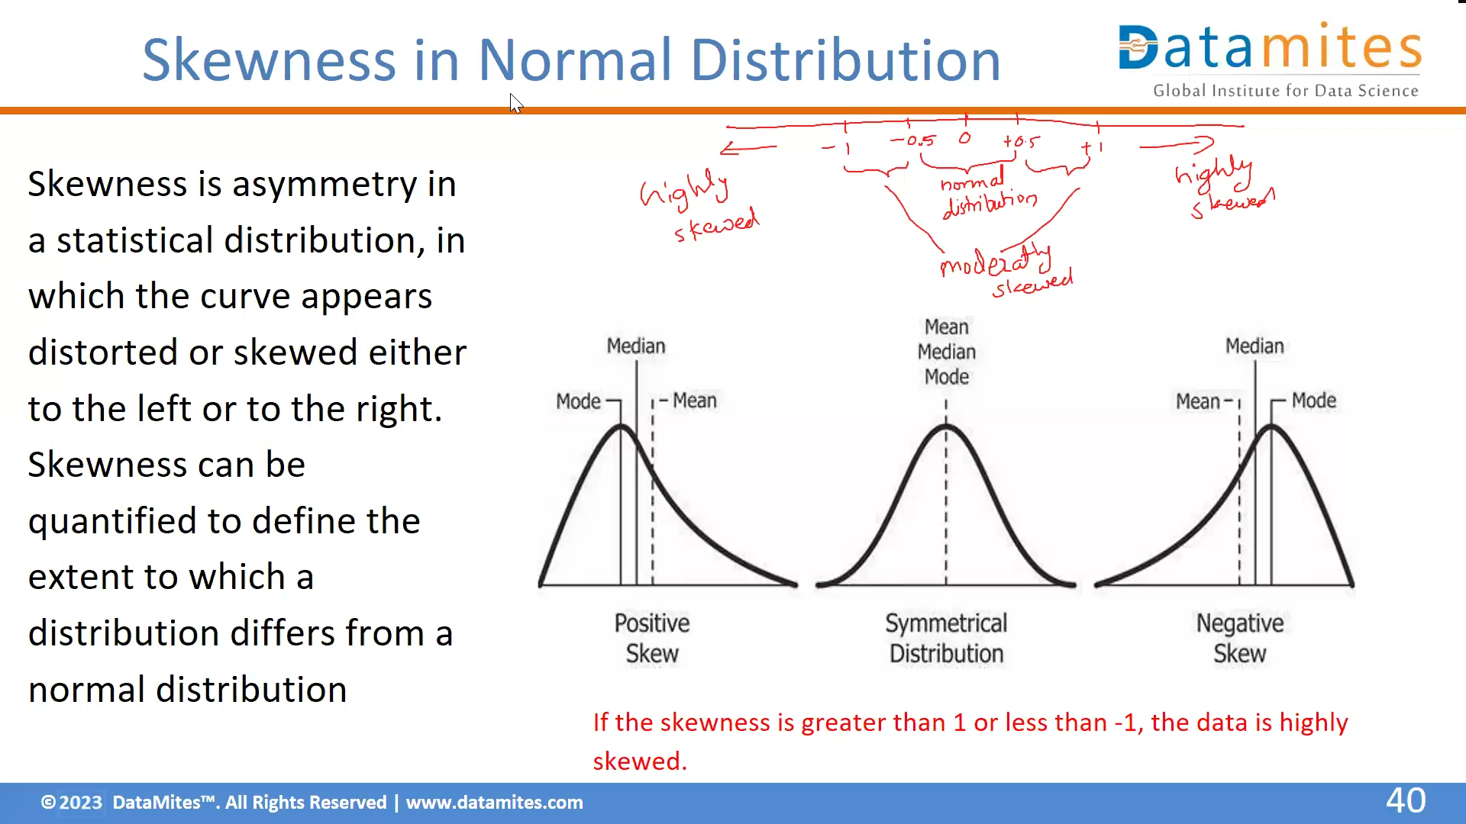

Slide 51
How much Skewness and Kurtosis
If the skewness is between -0.5 and 0.5, the data are fairly symmetrical. If the skewness is between -1 and – 0.5 or between 0.5 and 1, the data is moderately skewed.
If the skewness is greater than 1or less than -1, the data is highly skewed.
A standard normal distribution has kurtosis of 3 and is recognized as mesokurtic. An increased kurtosis (>3) can be visualized as a thin “bell” with a high peak whereas a decreased kurtosis corresponds to a broadening of the peak and “thickening” of the tails.

Slide 52
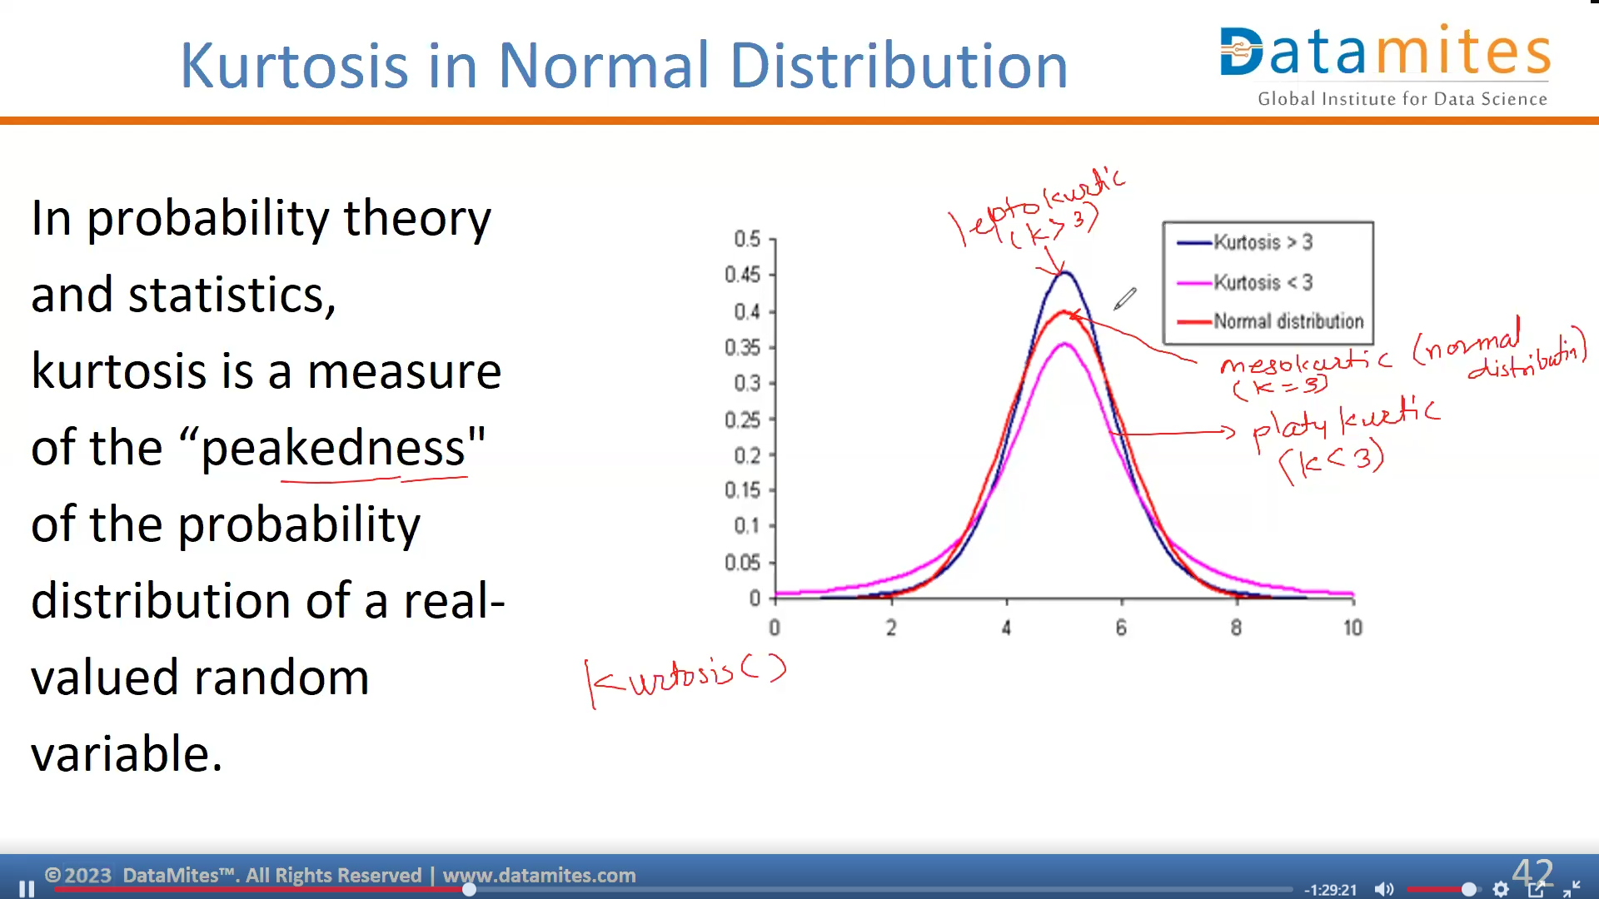

Slide 53
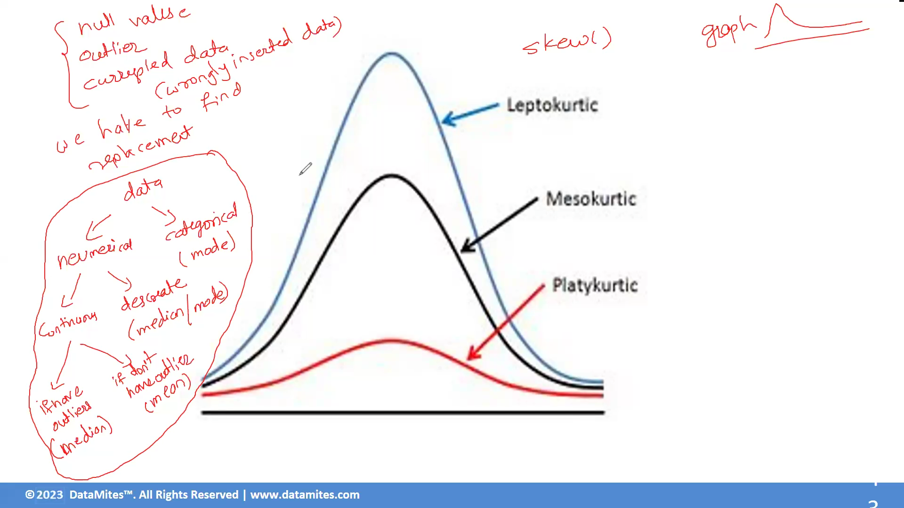

Slide 54
Which is Best—the Mean, Median, or Mode?
When you have a symmetrical distribution for continuous data, the mean, median, and mode are equal. In this case, analysts tend to use the mean because it includes all of the data in the calculations. However, if you have a skewed distribution, the median is often the best measure of central tendency.
When you have categorical or discrete data, the median or mode is usually the best choice. For categorical data, you have to use the mode.

Slide 55
Correcting Distortion in Normal Distribution
Log Transformation [Each data point is replaced with log(x) to obtain ND]
Square-Root Transformation [Each data point is replaced by its square root]
Reciprocal Transformation [ It takes the inverse of x ie., 1/x]
Box-Cox Transformation [Transformation of non-normal dependent variables to normal shape]
Reason: To transform the data to either reduce the skewness or to normalize the data or simply make the data easier to understand.
Transformation is nothing but taking a mathematical function and applying it to the data.

Slide 56
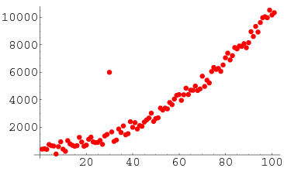
Outliers
An outlier is an observation point that is distant from other observations. An outlier may be due to variability in the measurement or it may indicate experimental error; the latter are sometimes excluded from the data set.
https://tribe.datamites.com/posts/outliers

Slide 57
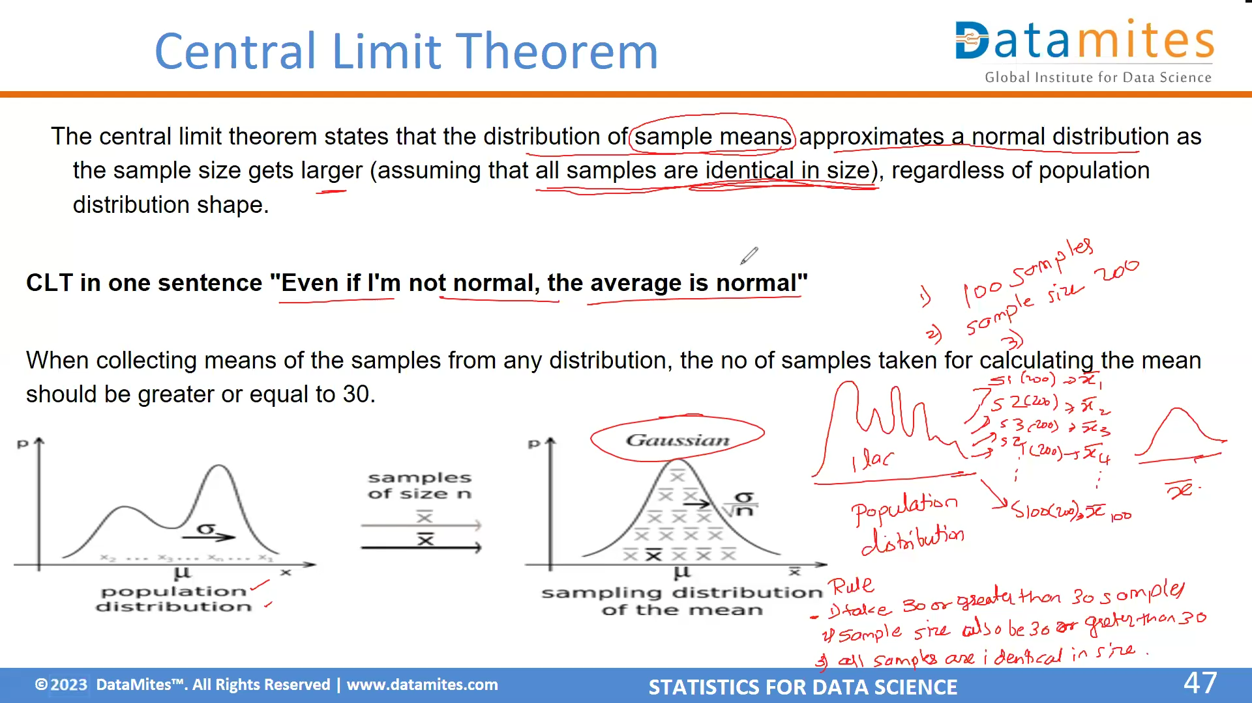
Whenever our population distribution does not follow normal distribution then we have to use Central Limit Theorem

Slide 58
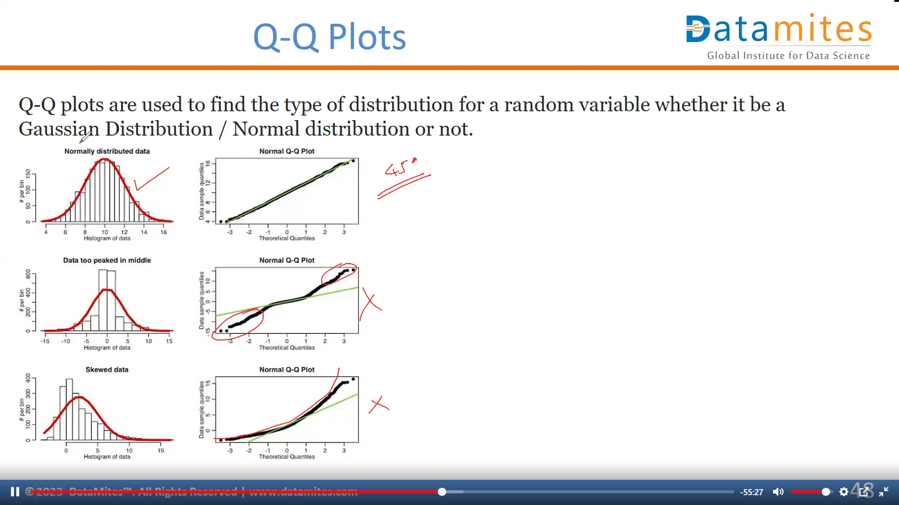

Slide 59
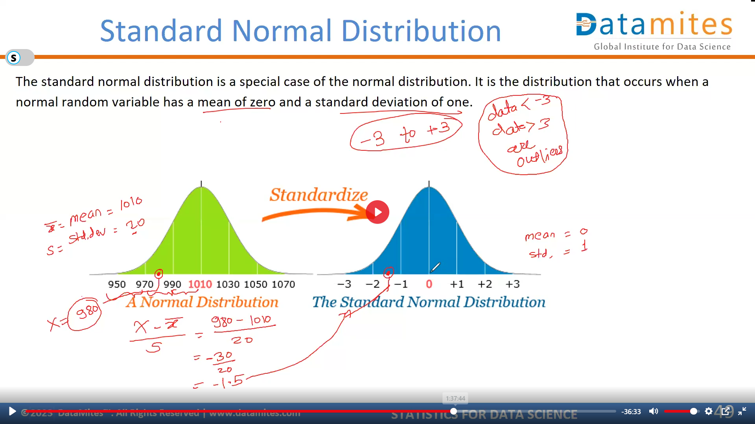

Slide 60
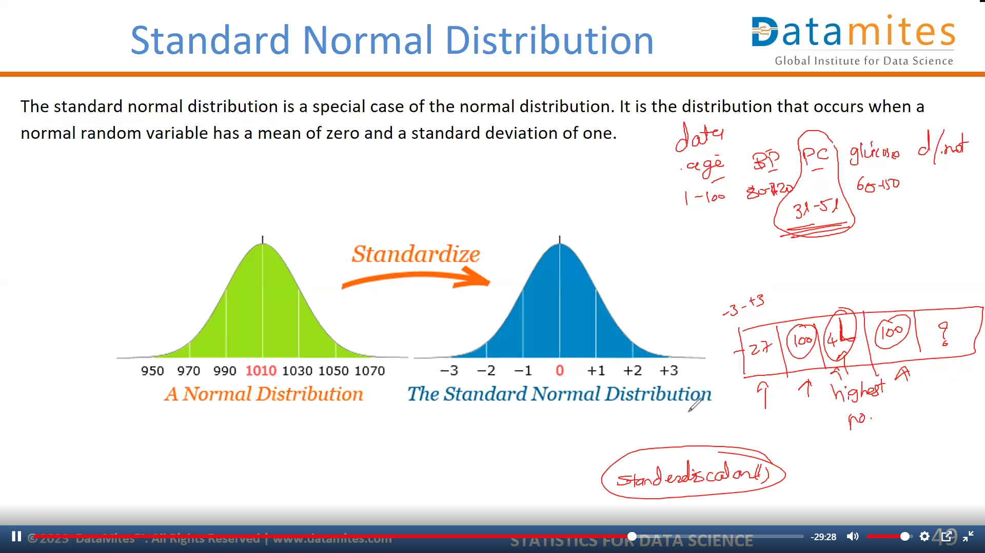

Slide 61
Why do we need to do standard normal Distribution
-> The Standard Normal Distribution is crucial in statistics because it simplifies calculations, helps compare different datasets, and is the foundation for many statistical methods.
1. Simplifies Complex Data
Many real-world datasets follow a normal distribution (bell-shaped curve). However, these datasets may have different means (µ) and standard deviations (σ).
Standardizing them using the Z-score formula:
Z = X − μ / standard deviation sigma
converts any normal distribution into the Standard Normal Distribution (mean = 0, standard deviation = 1).
This makes comparisons across different datasets easier.

Slide 62
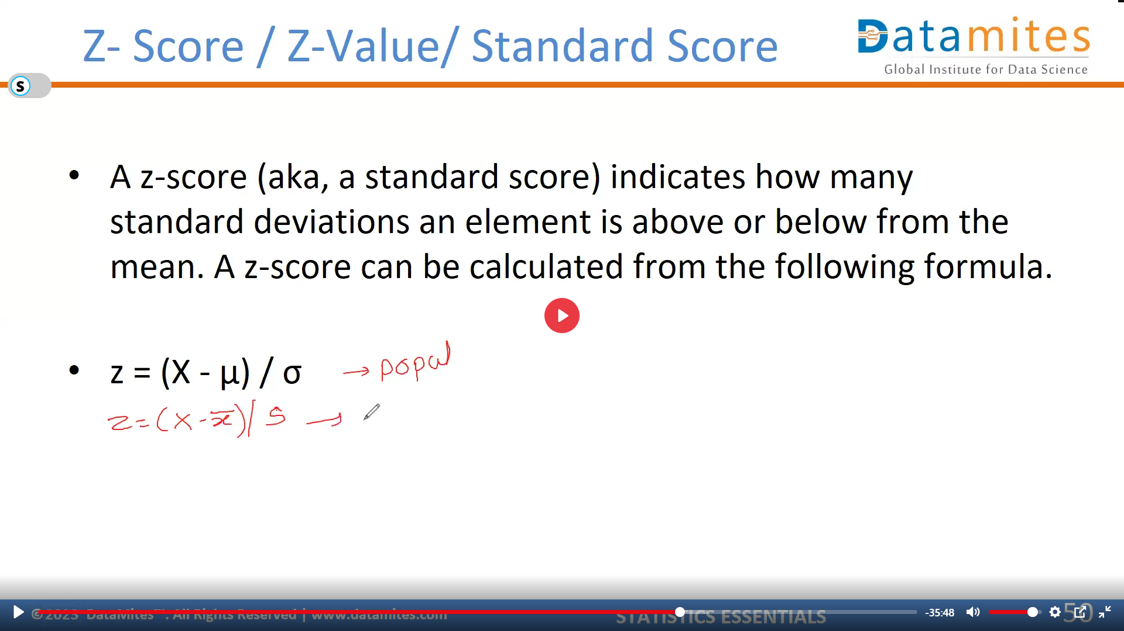

Slide 63
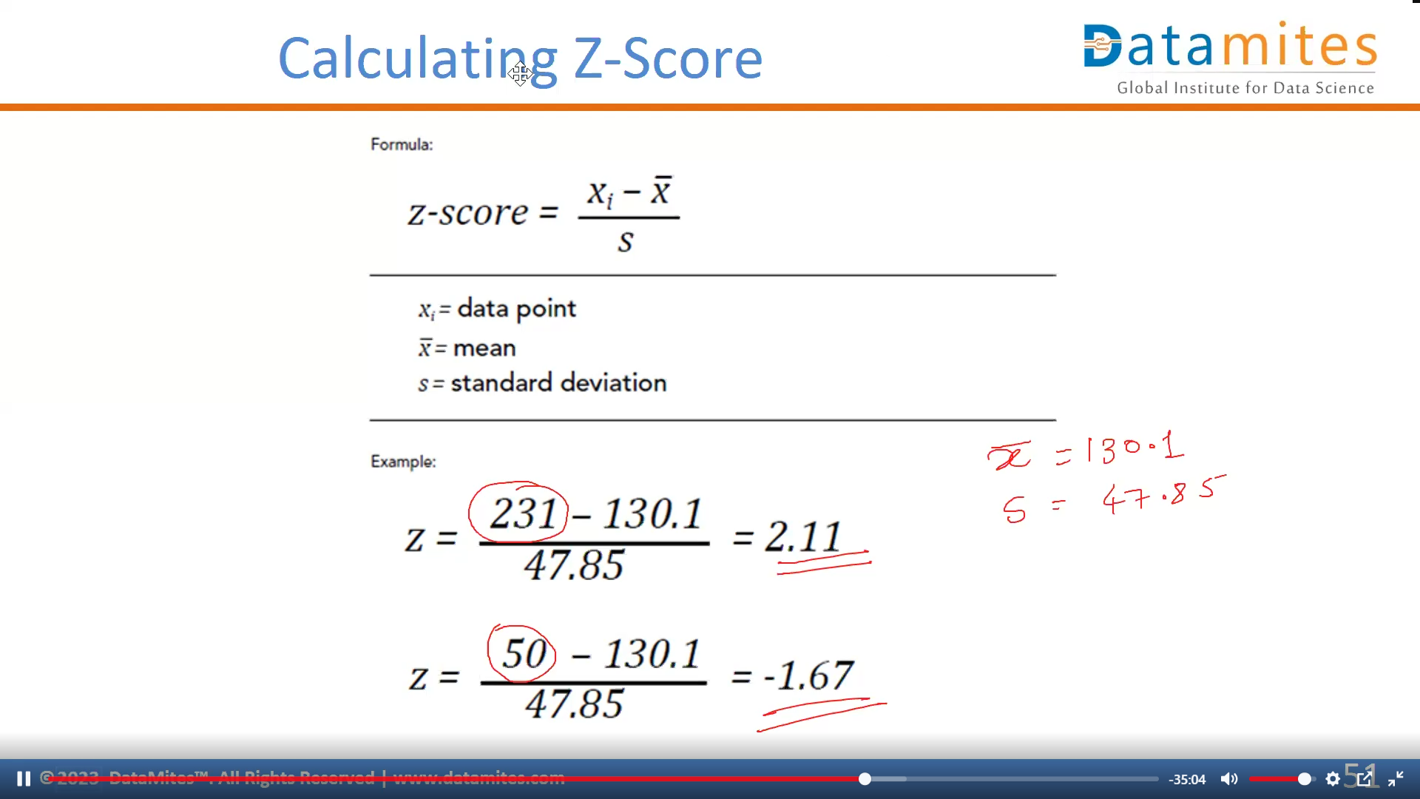

Slide 64
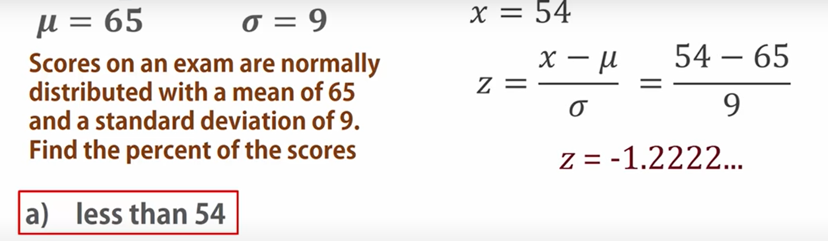

Slide 65
Outliers
- Z-scores generally range from -3.0 to +3.0.
- For bell shaped distributions, the empirical rule says 99.7% of all the data values have z-scores between -3.0 and +3.0.
- We consider any z-score that is either less than -3.0 or greater than +3.0 to be an outlier.

Slide 66
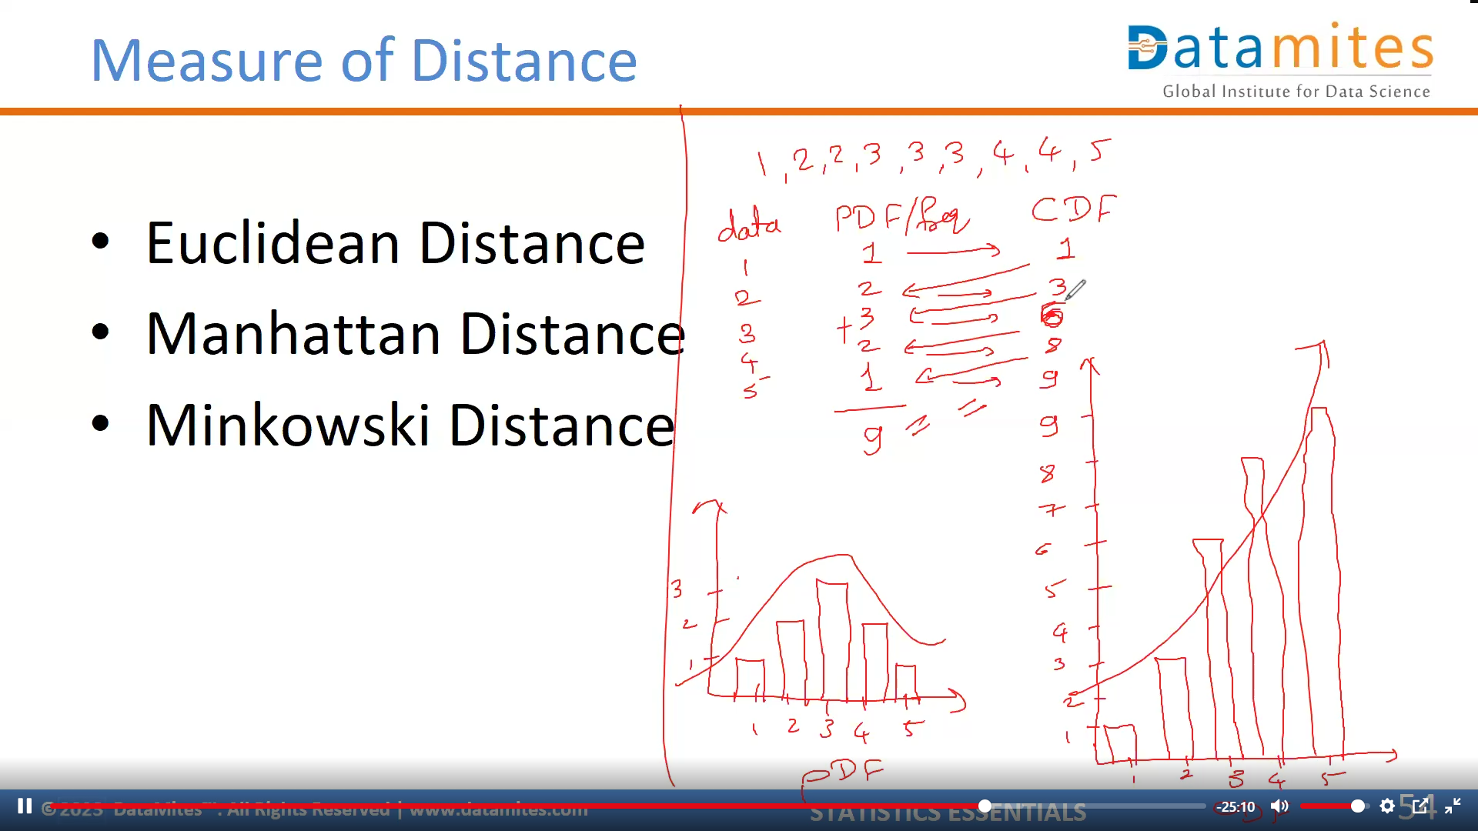

Slide 67
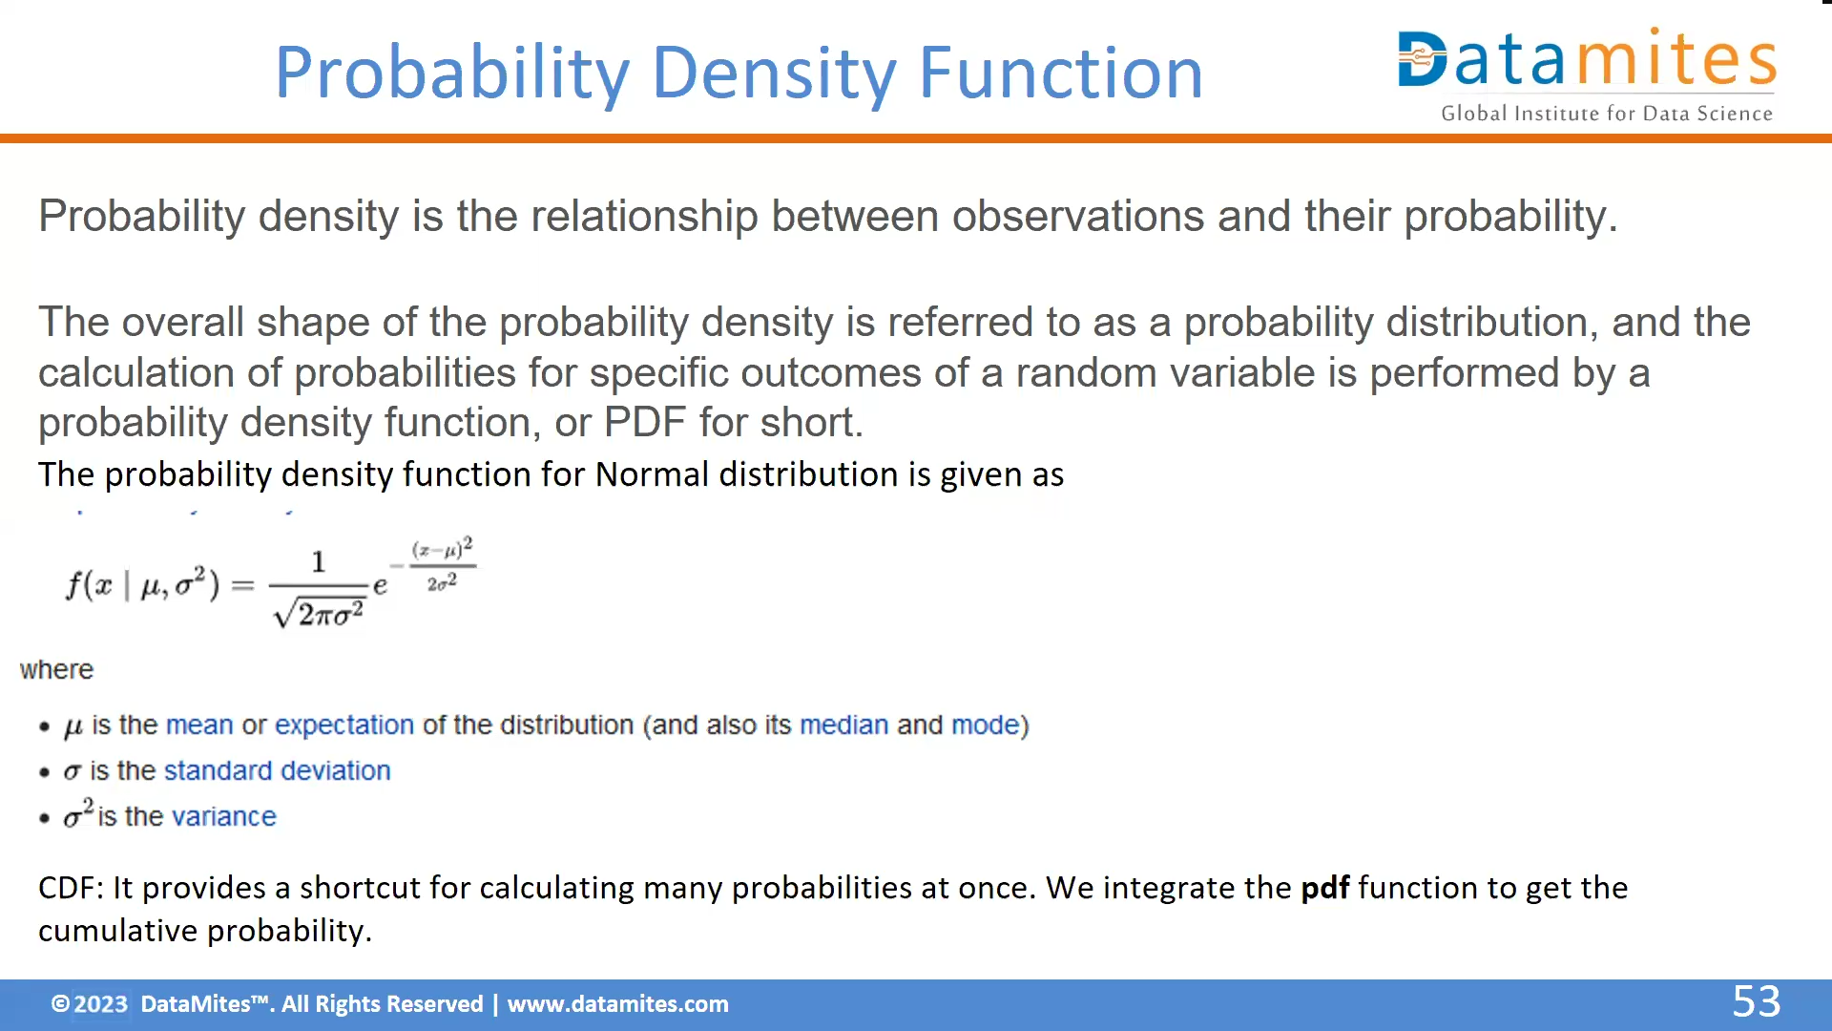

Slide 68
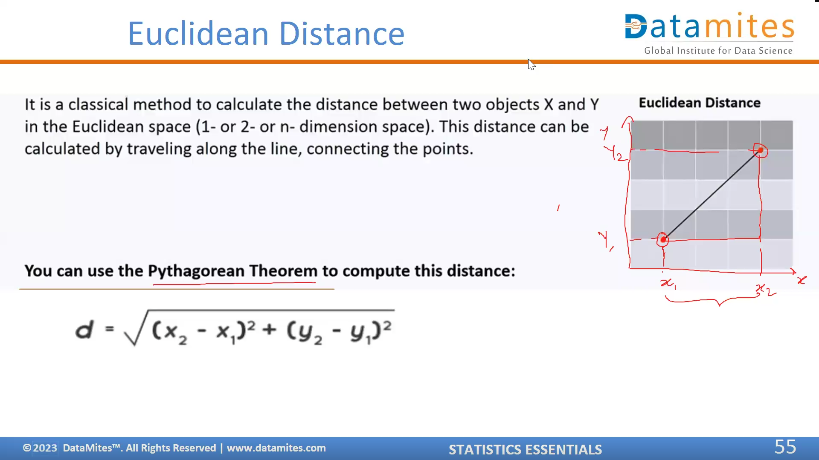

Slide 69
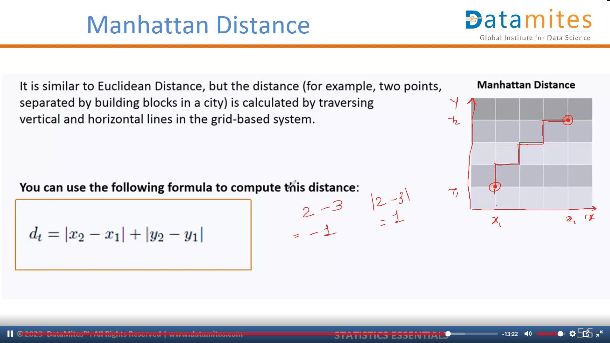
Mod of | x2 – x1 | gives positive values

Slide 70
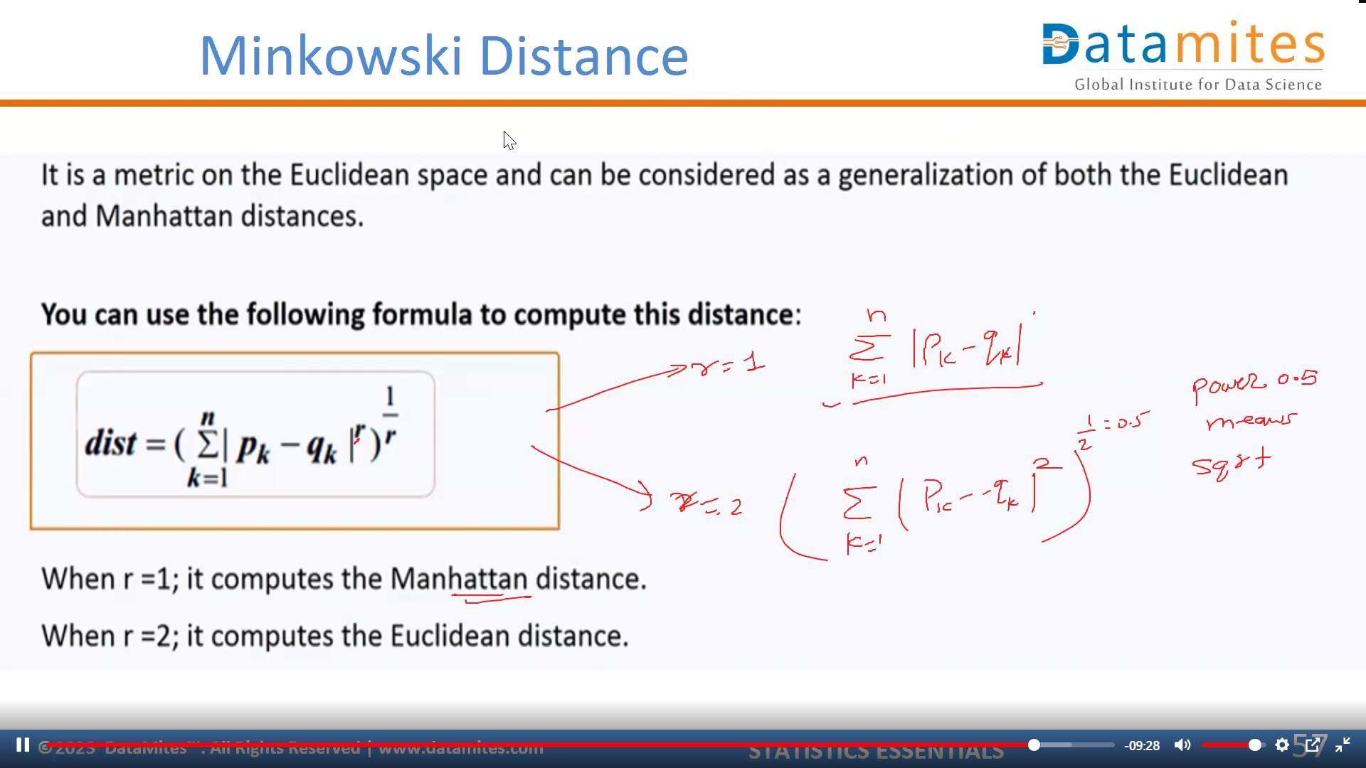
See another pdf for calculation of minkowski Distance

Slide 71
Use of Distance Metrics
Statistical distances are used for several important reasons:
Outlier Detection
Clustering Analysis
Feature Selection
Data Cleaning
Dimensionality Reduction

Slide 72
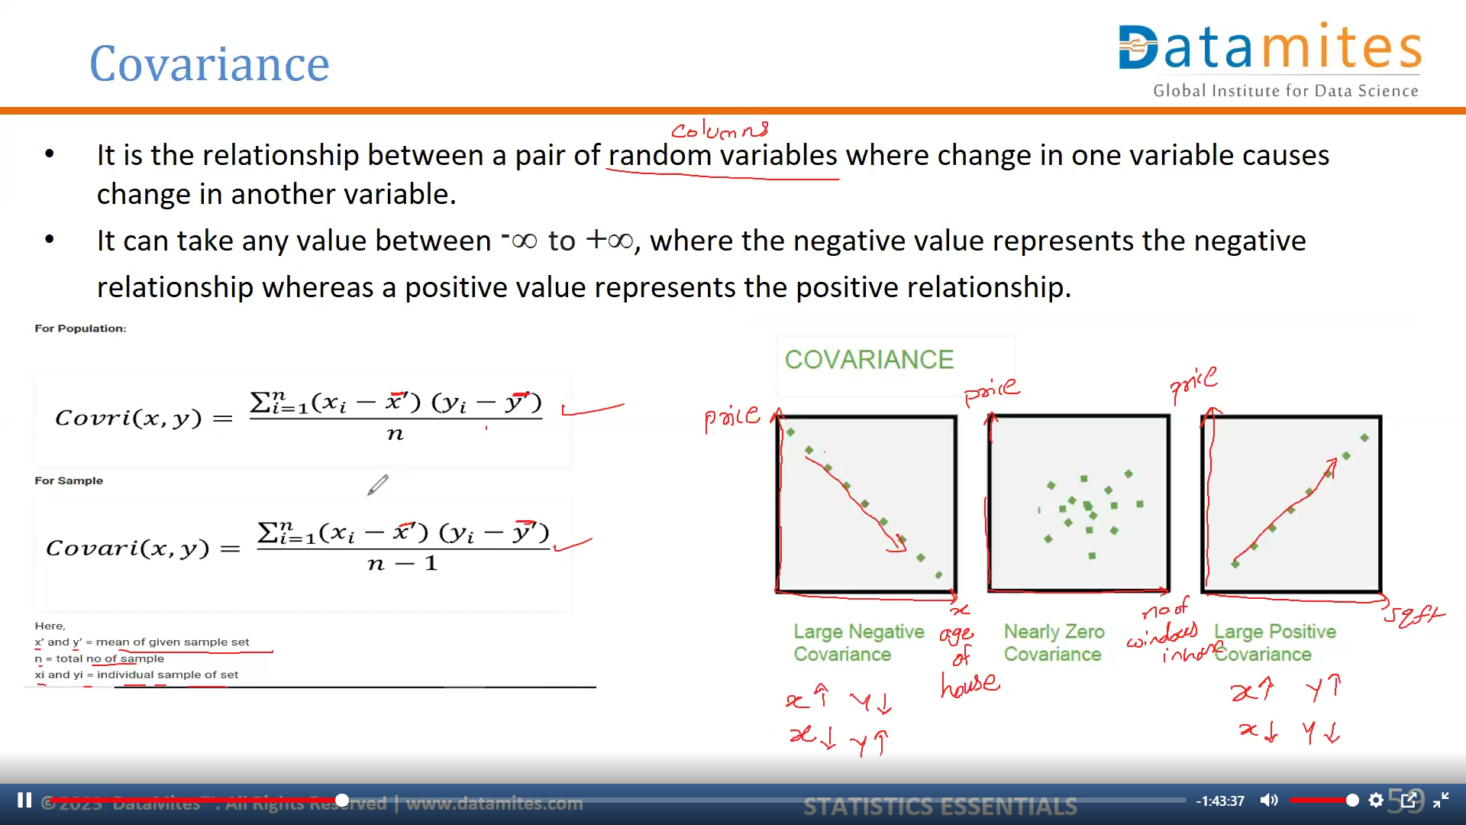

Slide 73
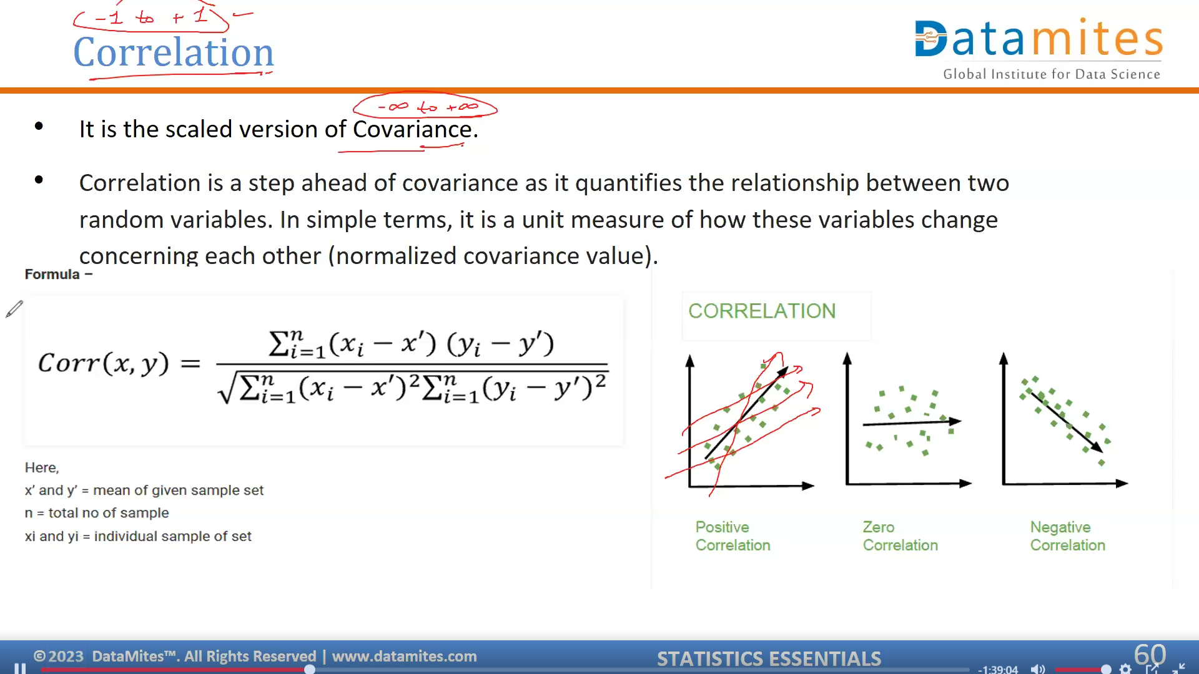

Slide 74
Based on the correlation coefficient, we can select the important features:
If the independent feature is not correlated with the target variable, we could remove that feature.
Or if two independent features are highly correlated, we could remove any one feature.

Slide 75
Hypothesis Testing & Other computational Techniques
Module - 4

Slide 76
Hypothesis Testing
Hypothesis is a statement, assumption or claim about the value of the parameter (mean, variance, median etc.).
A hypothesis is an educated guess about something in the world around you. It should be testable, either by experiment or observation.
Ex:-if we make a statement that “Dhoni is the best Indian Captain ever.” This is an assumption that we are making based on the average wins and loses team had under his captaincy. We can test this statement based on all the match data.

Slide 77
Comparing and Analyzing Relationships
Does the treatment with new drug help more patients than the standard treatment with old drug?
Which of these four methods is the most efficient way of teaching machine learning?

Slide 78
Types of Hypothesis
When a hypothesis specifies an exact value of parameter, it is simple hypothesis. For eg., A motorcycle company claiming that a certain model gives an average mileage of 100 km per litre, this is a case of simple hypothesis.
If a hypothesis specifies a range of values then it is called a composite hypothesis. For eg., Average age of students in a class is greater than 20. This statement is a composite hypothesis.

Slide 79
Null Hypothesis (H₀)
The null hypothesis is the hypothesis to be tested for possible rejection under the assumption that it is true.
The concept of the null is similar to innocent until proven guilty.

Slide 80
Alternate Hypothesis (H_{A})/(H1)
The alternative hypothesis complements the Null hypothesis.
It is opposite of the null hypothesis such that both the alternate and null hypotheses together cover all possible values of the population parameter.

Slide 81
Hypothesis Testing – Case Discussion
Consider a court of law:
The null hypothesis always begins with the assumption that the defendant is innocent.
We require evidence to reject the null hypothesis (convict the defendant).
When we collect evidence and try to reject null hypothesis, there are 2 errors that could potentially occur: Type 1 or Type 2 error.

Slide 82
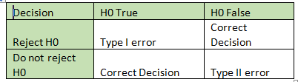
Type I and Type II Error

Slide 83

Critical Region
The critical region is that region in the sample space in which if the calculated value lies then we reject the null hypothesis.
The critical region lies in one tail or two tails on the probability distribution curve according to the alternative hypothesis.
The value of critical region is denoted by α.
It is known as level of significance. i.e what is passing criteria of test.

Slide 84

Cases Of Critical Region
Three cases of Critical Region arise.
If the alternate hypothesis gives the alternate in both directions (less than and greater than) of the value of the parameter specified in null hypothesis, it is called Two-tailed test.
E.g. H0: mean= 100 —-> H1: mean not equal to 100
Here according to H1, mean can be greater than or less than 100. This is an example of Two-tailed test.
If the alternate hypothesis gives the alternate in only one direction (either less than or greater than) of the value of the parameter specified in null hypothesis, it is called One-tailed test.
E.g. H0: mean>=100 —-> H1: mean< 100

Slide 85

p –Value
Since we know that passing value of a test can be 1% or 5%. But we must also know what are the test score and this test score is known as p- value.
Technically p-value (probability value) is the smallest level of significance at which a null hypothesis can be rejected.
If p-value is greater than alpha, we do not reject the null hypothesis.
If p-value is smaller than alpha, we reject the null hypothesis.

Slide 86

Process of Hypothesis Testing
Set up Null hypothesis and Alternate hypothesis.
Decide the level of significance (1% or 5%).
Select the test as per requirement.
Calculate the p-value.
If p-value less than level of significance, reject the null hypothesis.
If p-value more than level of significance, accept the null hypothesis.

Slide 87
Types of Hypothesis Tests
Parametric Tests:-Those test which considers the shape of distribution of sample.
Non – Parametric Tests:-Those test which do not considers the shape of distribution of sample.

Slide 88
Applications of Hypothesis Testing
Feature Selection
Model Evaluation & Selection
Hyper Parameter Tuning
Anomaly Detection

Slide 89
Hypothesis Tests:-Parametric
Z test
T/Student’s T test
Paired t Test
One Way ANOVA

Slide 90
Hypothesis Tests:-Non Parametric
Chi Square Test
Mann-Whitney Test
Wilcoxon Signed-Rank Test
Kruskal-Wallis Test
Friedman’s ANOVA

Slide 91

T-test
A t-test is an analysis of two populations means through the use of statistical examination; a t-test with two samples is commonly used with small sample sizes, testing the difference between the samples when the variances of two normal distributions are not known.
This helps in finding the association between Categorical and Continuous features.
X -> Mean of sample set
μ -> Mean of Population
S -> Standard deviation of sample
N -> Sample size

Slide 92

T-test

Slide 93



T-test
The T-Test helps to determine whether there is a statistically significant difference in the average salaries between these two groups.
H0: There is no significant difference between two groups.
Female Group:
Mean=10,70,000 SD=3,95,995.81
Male Group:
Mean=9,02,000 SD=7,52,807.45
T-Statistics = 4.24
P-Value = 0.001 (From T-Table)
There is a significant difference in salaries between the two groups.

Slide 94

Paired T-test
The paired t-test is performed when the samples typically consist of matched pairs of similar units, or when there are cases of repeated measures.
For example, there may be instances of the same patients being tested repeatedly—before and after receiving a particular treatment. In such cases, each patient is being used as a control sample against themselves.

Slide 95

One-Way ANOVA
The one-way analysis of variance (ANOVA) is used to determine whether there are any statistically significant differences between the means of three or more independent (unrelated) groups. Eg.,
Within Group Variance - Values within the group are close to each other
Between Group Variance - Values between groups are not close to each other

Slide 96
One-Way ANOVA
If the within-group variation is less and between-group variation is high, then it means this feature impacts the target variable. Hence it is an important feature.

Slide 97

Chi-Square Test
Chi-square test is used for categorical features in a dataset. We calculate Chi-square between each feature and the target and select the desired number of features with best Chi-square scores. It determines if the association between two categorical variables of the sample would reflect their real association in the population. Chi- square score is given by
Observed frequency = No. of observations of class
Expected frequency = No. of expected observations of class if there was no relationship between the feature and the target. Expected Frequency = (Row Total * Column Total)/N

Slide 98


Contingency Table:
The chi-squared value for the given contingency table is 0.257
Significance level is 0.05
The observed p-value is 0.967902
Since p-value > 0.05, we accept the Null hypothesis.

Slide 99

Thank You.

